Slide 1
dsjfgk\'/ lhNnfsf k|d'v lhNnf clwsf/L / sfof{no k|d'vx? nufotsf] Ifdtf clea[l4 sfo{s|d
;"rgfsf] xs -v'Nnf ;/sf/ ;fem]bf/L / v'Nnf ;/sf/L tYofs ;lxt_ / ;sf/fTds ;f]r
-Basic Knowledge on Right to Information (Open Government Partnership and Open Government Data) and Positive Thinking)
;"rgfsf] xs / ;sf/fTds ;f]r
s[i0fxl/ afF:sf]6f
k"a{ k|d'v ;"rgf cfo'Qm tyf g]kfn ;/sf/sf] k"a{ ;lrj

Slide 2
;"rgfsf] xssf] ;fdfGo hfgsf/L
Basic Knowledge of Right to Information

Slide 3
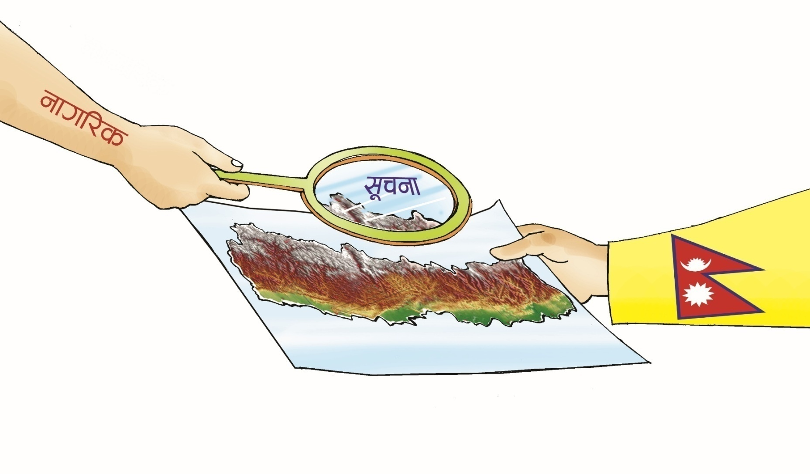
;"rgfsf] clwsf/ eg]sf] ;fa{hlgs lgsfosf ultlalwnfO{ gful/sn] DoflUgkmfO{g Unf;n] x]g]{ lalw xf] .

Slide 4
;+ljwfg k|bQ xs
;"rgf dfUg] xs
cfkm\gf] ;/f]sf/sf]
;fj{hlgs rf;f]sf]
h'g;'s} laifosf] ;"rgf
;"rgf kfpg] xs

Slide 5

Nff]stGq
nf]stGqsf] cfwf/e"t d"No / dfGotf
    ;'-zf;g
    Kff/blz{tf
    hJffkmb]xL zf;g k|0ffnL
    Kf|]; tyf cleJolQm :jtGqtf gful/ssf] ;"rgfsf] xs
    Gfful/s ;zlQms/0f
    gful/ssf] ;"rgfsf] xs Ö nf]stGq

Slide 6
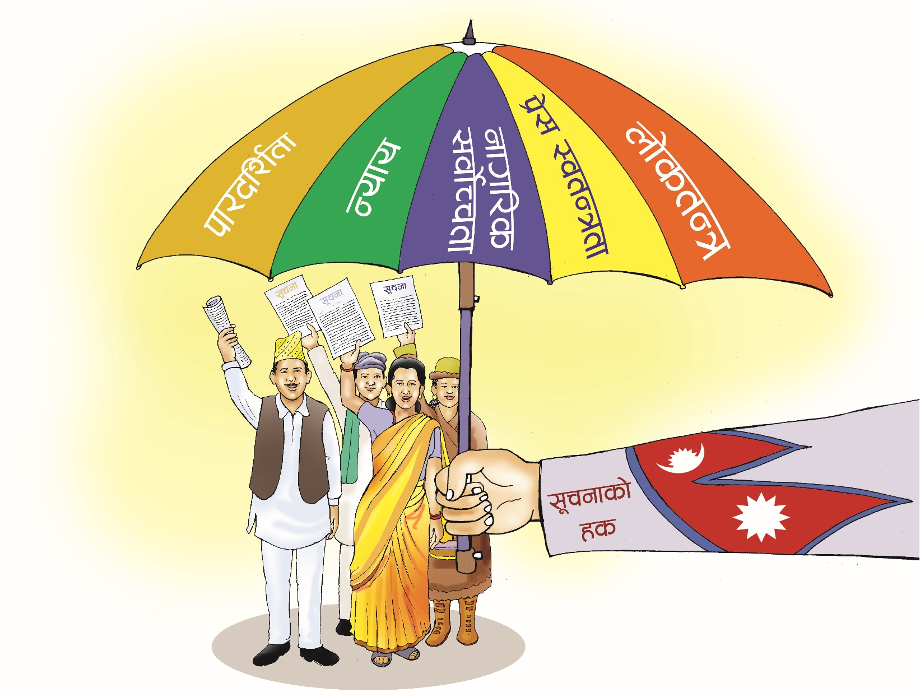
;"rgfsf] sfg"gn] gful/snfO{ wfd kfgL af6 hf]ufp5 .

Slide 7
;"rgfsf] xs;DaGwL P]gsf] k|:tfjgf
/fHosf sfd–sf/afxL nf]stflGqs k2lt cg'?k x'g'kg]{
tL lgsfosf sfd–sf/afxL v'Nnf / kf/blz{ x'gkg]{
tL gful/sk|lt hjfkmb]xL / lhDd]jf/ x'g'kg]{
cfk"m;Fu /x]sf] ;fj{hlgs dxTjsf] ;"rgfdf gful/snfO{ ;xh kx'Fr lbg'kg]{

Slide 8
;"rgf dfu ug{ ;lsg] ;fj{hlgs lgsfox?
;+3Lo ;/sf/
k|fb]lzs ;/sf/
:yfgLo tx
;+j}wflgs c+ux?
;a} k|sf/sf ;/sf/L lgsfox?
/fhg}lts bnx?
u}/ ;/sf/L ;+:yfx?
lghL If]q
sfg"gåf/f :yflkt h'g;'s} ;+:yf

Slide 9
;"rgf dfustf{n] k"/f ug'{ kg]{ zt{x?
;"rgf clwsf/L;Fu lnlvt ;"rgf dfUg]
;"rgf dfusf] k|of]hg v'nfpg' kg]{
g]kfnL gful/s x'g' kg]{
b:t'/ ltg{ ;xdt x'g' kg]{
lgj]bgdf ;"rgfsf] xs v'nfpg' kg]{

Slide 10
;"rgf kfpg] ;do ;Ldf
dfu ePsf] ;"rgf tTsfn lbg' kg]{
hLp Hofgsf] ;'/Iff;Fu ;DalGwt ;"rgf @$ 306f leq lbg' kg]{
sfof{no k|d'v ;dIf ph'/L k/]sf]df & lbgleq lbg' kg]{
;"rgf ;+sng u/]/ lbg'kg]{ eP clwstd\ !% lbgleq lbg' kg]{

Slide 11
;"rgfsf] b:t'/
lgj]bg, ph'/L / k'g/fj]bg btf{ ubf{ s'g} b:t'/ gnfUg]
x'nfs l6s6 6fF:g' gkg]{
k|yd !) k[i7 lgMz'Ns kfO{g]
P3f/ k[i7b]lv k|lt k[i7 ?= % nfUg]
k|yd cfwf 306fsf] cjnf]sg b:t'/ lgMz'Ns x'g], To;kl5 k|lt JolQm k|lt 306f ?= %) b:t'/ nfUg]

Slide 12
:jtM k|sfzgsf] Joj:yf
gful/sn] ;"rgf dfu gu/] klg ;"rgf k|jfx ug]{ ljlw
k|To]s #÷# dlxgfdf :jtM k|sfzg ug]{
:jtM k|sfzgdf @) cf]6f zLif{sleq ;"rgf k|jfx ug]{
;fpg–c;f]h, sflt{s–k';, df3–r}t, a}zfv–c;f/sf] :jtM k|sfzg !% lbgleq ug]{
o:tf] :jtM k|sfzg j]j;fO{6, ;"rgf kf6L, ˆn]S; af]8{, xf]l8{Ë af]8{, a'n]l6g nufotdf k|sflzt ug]{

Slide 13
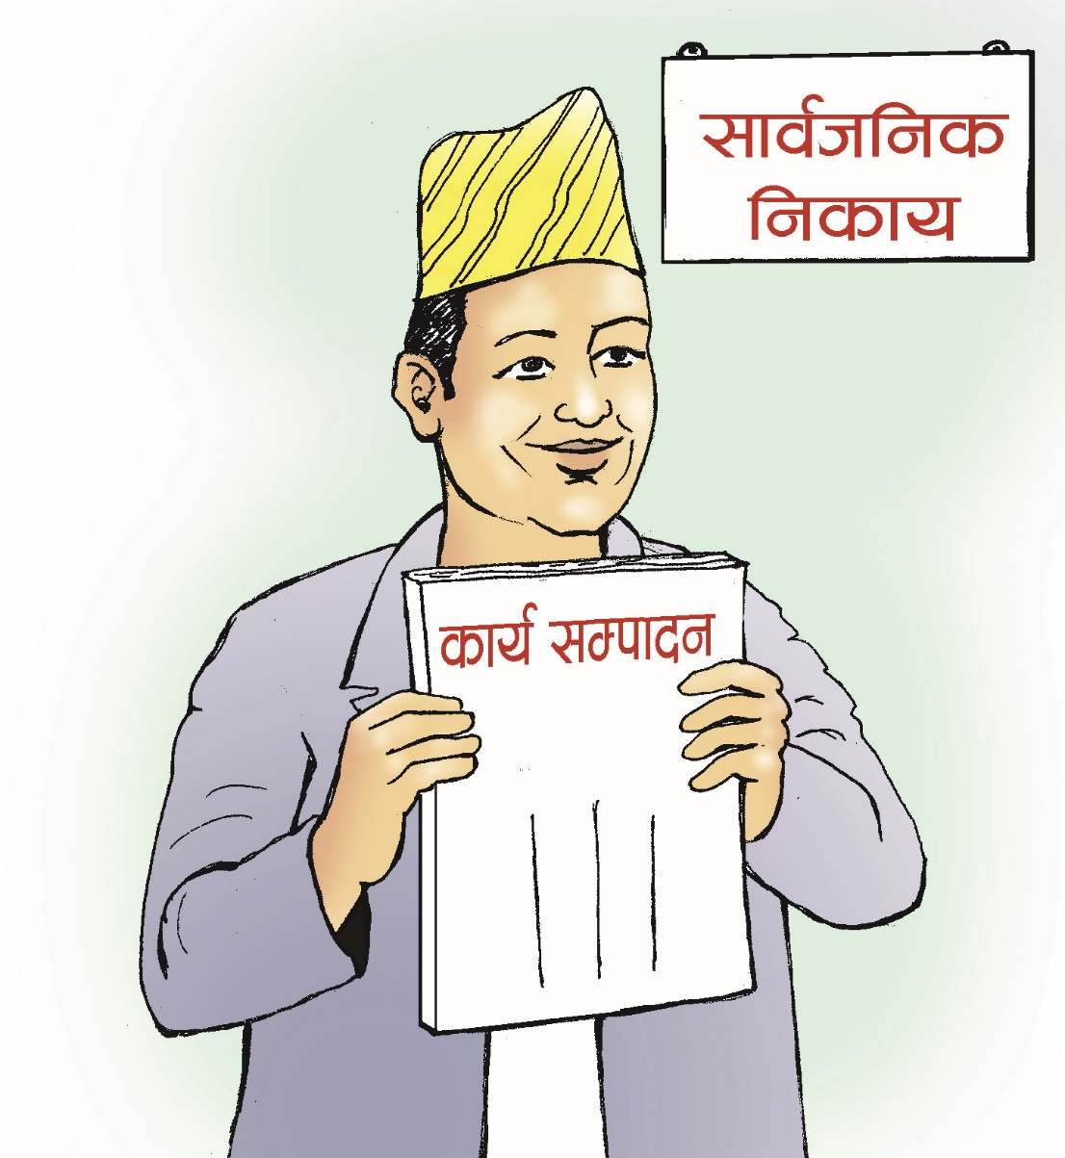
d':sfg ;lxtsf] ;'zf;gMtLg dlxg] :jtM k|sfzg

Slide 14
;"rgf clwsf/Lsf] Joj:yf
k|To]s lgsfodf ;"rgf clwsf/L tf]Sg]
;"rgf clwsf/Lsf] gfd, ;Dks{ gDa/ / kmf]6f] ;lxtsf] ˆn]S; af]8{ ;fj{hlgs x'g]
;"rgf clwsf/Ln] dfu ePsf] ;"rgf tTsfn lagf lxrlsrfx6 lbg]
cfjZostfg';f/ ;"rgf clwsf/Lsf] ;+/If0f /fli6«o ;"rgf cfof]un] ug]{
sfof{non] ;"rgf clwsf/LnfO{ lgoldt?kdf ;"rgf pknAw u/fpg' kg]{

Slide 15
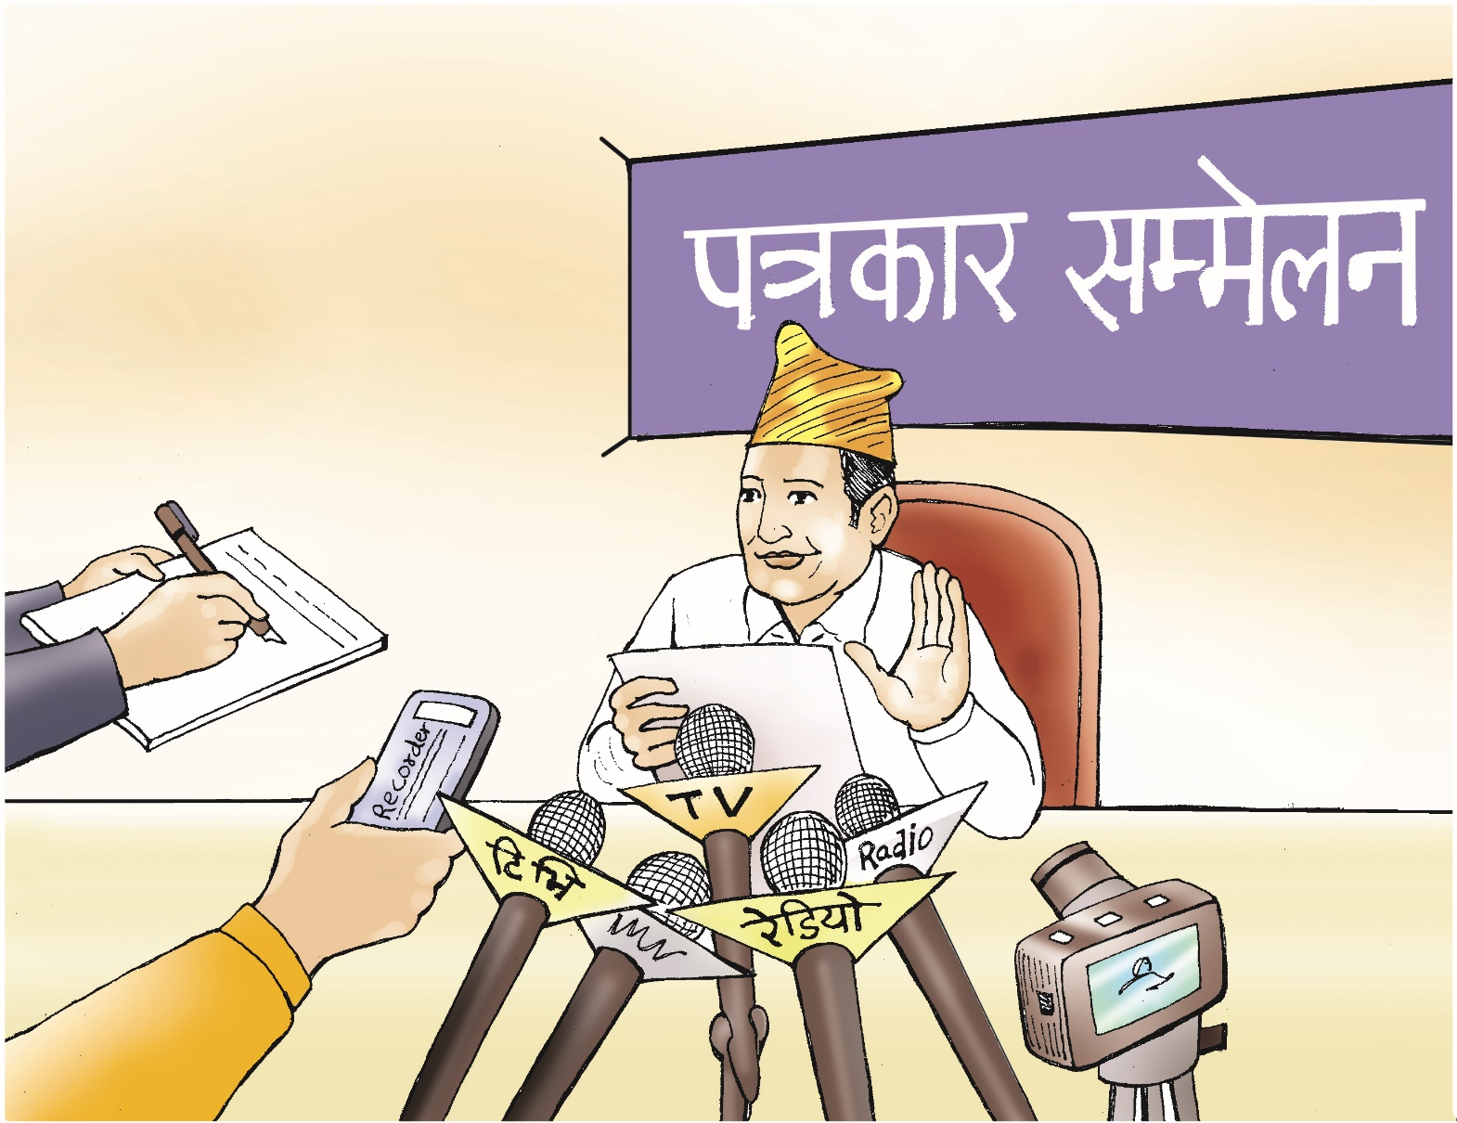
;"rgf clwsf/L lelhjn x'g' k5{ .

Slide 16
;fj{hlgs lgsfosf] bfloTj
gful/ssf] ;"rgfsf] xssf] ;Ddfg ug]{
lbg ldNg] / gldNg] ;"rgf 5'6\ofP/ /fVg]
ljleGg /fli6«o efiffdf ;"rgf tof/ ug]{
;"rgf k|jfxdf cfd ;~rf/sf] k|of]u ug]{
;"rgf k|jfxdf bIf t'Nofpg sd{rf/LnfO{ tfnLd lbg]
slDtdf @) aif{;Ddsf ;"rgf cBfjlws ug]{
clwstd\ v'nf;fsf] l;4fGt ckgfpg]

Slide 17

;"rgf glbg]nfO{ cfof]un] ;"rgf lbg' eGg] cfb]z u5{ .

Slide 18

cfof]usf] cfb]z kfngdf c6]/L ug]{nfO{ cfof]un] b08 u5{ .

Slide 19
;hfosf] Joj:yf
?= @% xhf/;Dd hl/jfgf
b}lgs ?= @))÷– hl/jfgf
c6]/L afkt yk ?= !) xhf/ hl/jfgf
ljefuLo sf/afxL

Slide 20
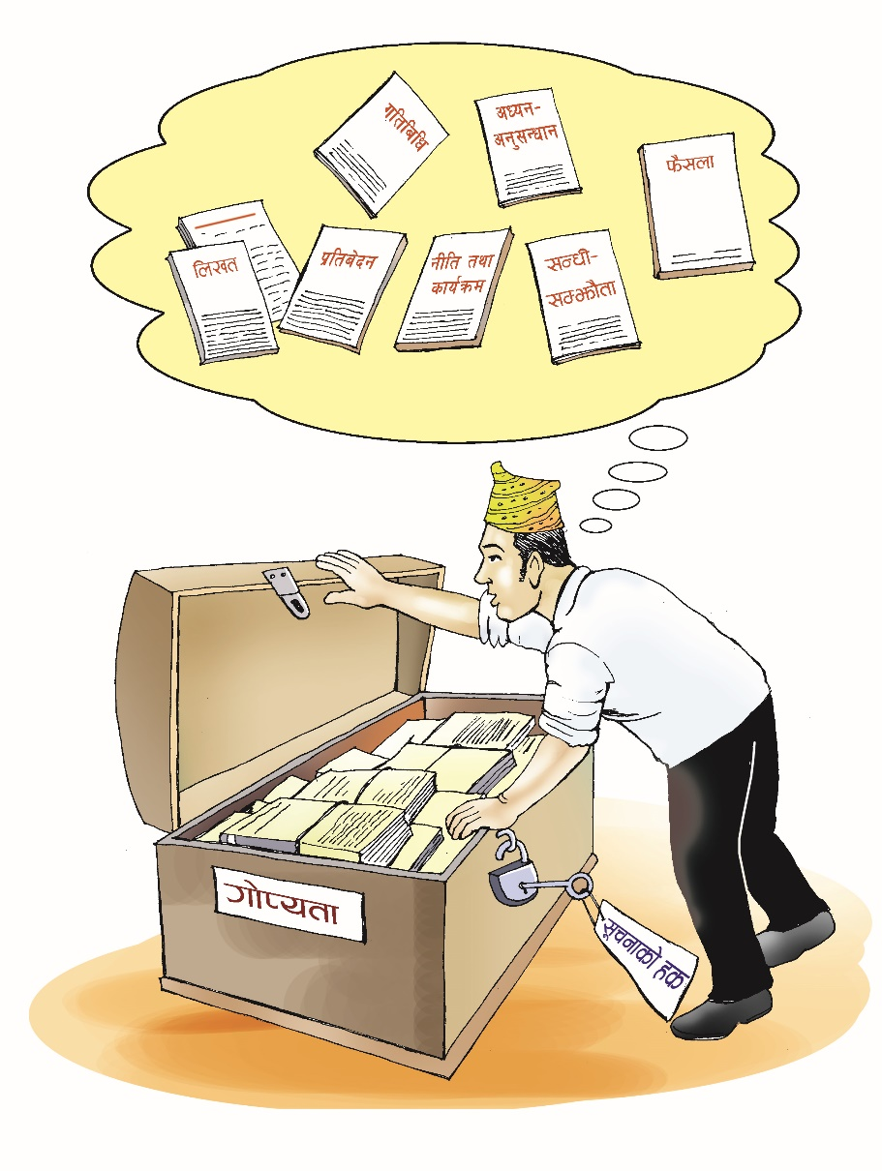
;"rgfsf] sfg"gdf ckjfbsf] l;4fGt 5 .

Slide 21
;"rgf k|jfxdf afWo gx'g] laifox?
) ;fj{ef}d;Qfdf vnn kg]{
) ;'/Iffdf c;/ kg]{
) cGt/f{li6«o ;DaGwdf vnn kg]{
) ck/fwsf] cg';Gwfgdf c;/ kg]{
) hflto ;befj e8\lsg] laifo,
/
JolQmut uf]kgLotfsf laifox?
) cfly{s lxtdf c;/ kg]{
) af}l4s lxtdf c;/ kg]{
) a}lsË uf]kgLotdf c;/ kg]{

Slide 22
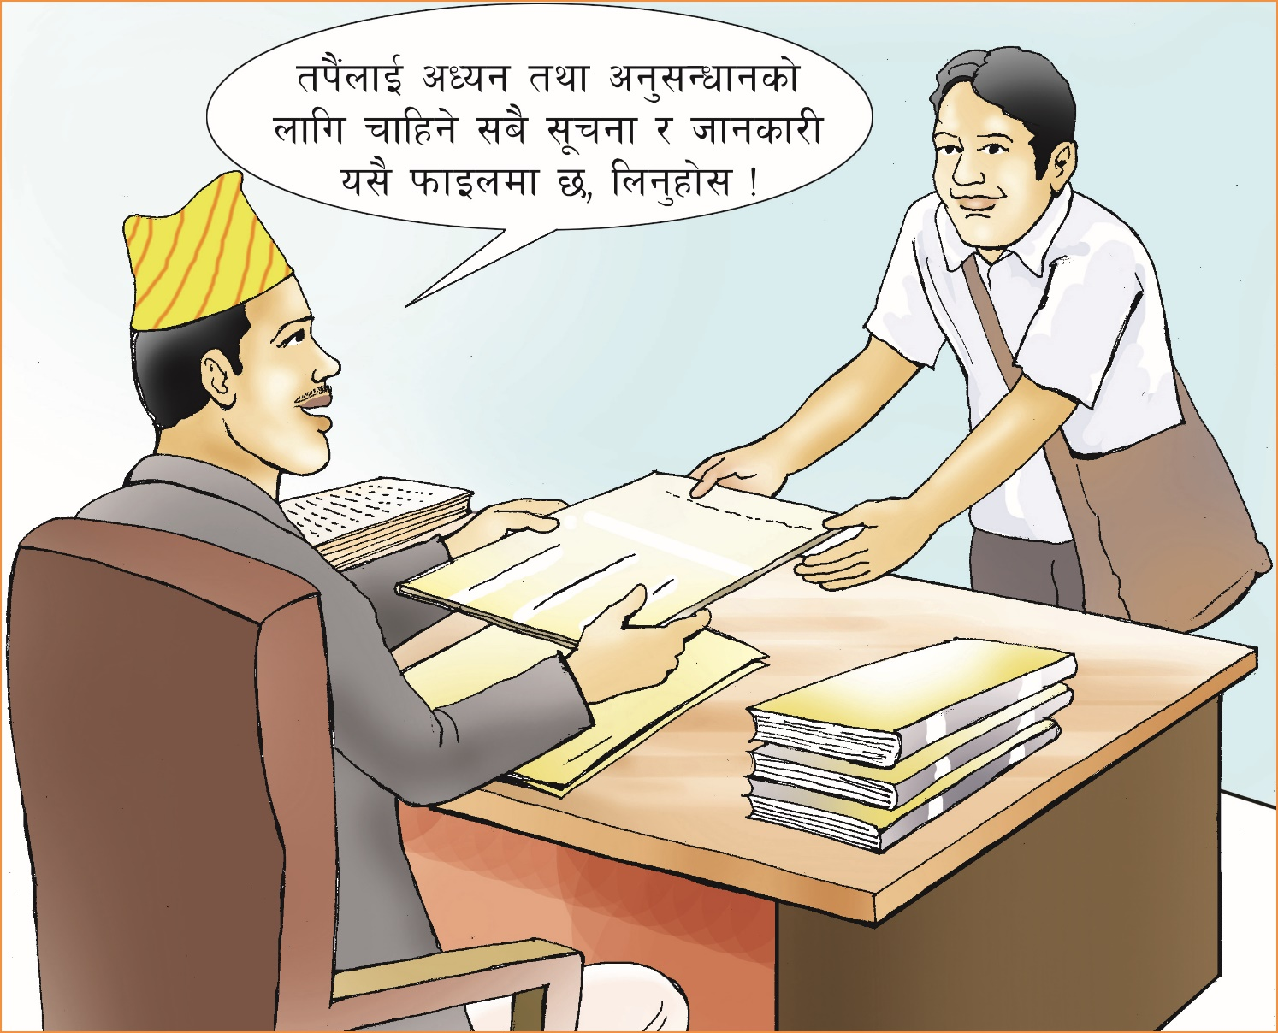
gful/s;+u lagozLntfk"a{s k|:t't x'g'k5{ .

Slide 23
;"rgfsf] xs s:tf] xs xf] <
;+s6sfnsf] l;ldt calwdf afx]s slxNo} lgnDag x'Fb}g
;jf]{Rr cbfnt / pRr cbfntn] cfb]z ug{ ;S5g\
k/dfb]z, k|ltif]w, pTk|]if0f, aGbL k|TofIfLs/0f, clwsf/ k[R5f
of] df}lns xs xf]
;+/If0f, ;Da4{g / k|rngdf /fli6«o ;"rgf cfof]u 5
o;y{ gful/ssf xs dWo]sf] >]i7 xs xf]

Slide 24
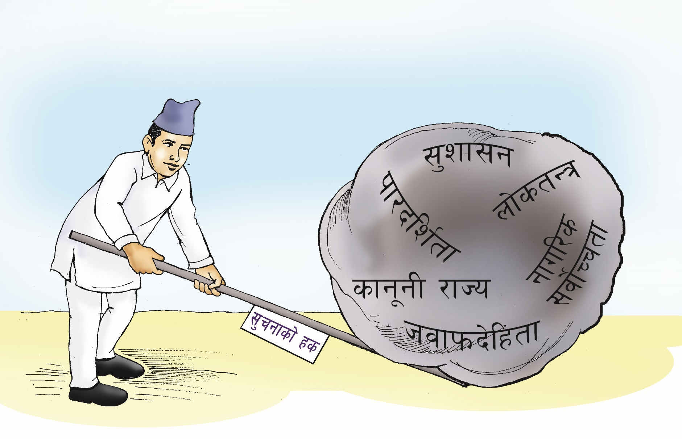
hgtfn] ;"rgfsf] xs dfkm{t ;'zf;gsf] cg'e"lt u5{g\ .

Slide 25
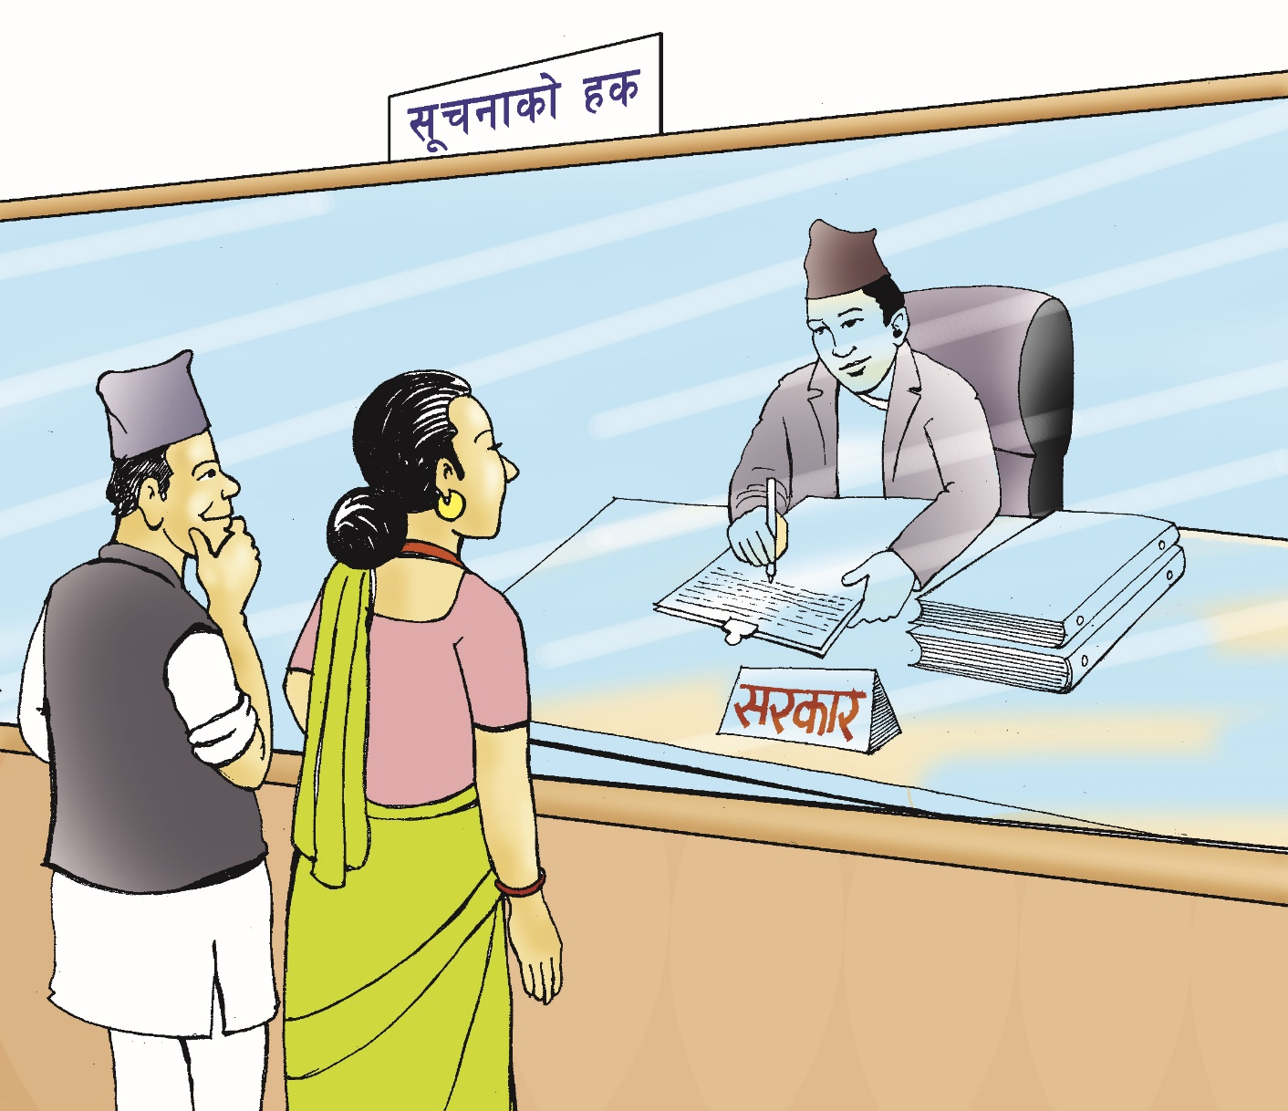
;"rgf df+ustf{n] x]bf{ x]b}{ ;"rgf kfpg' cfbz{ ca:yf xf] .

Slide 26
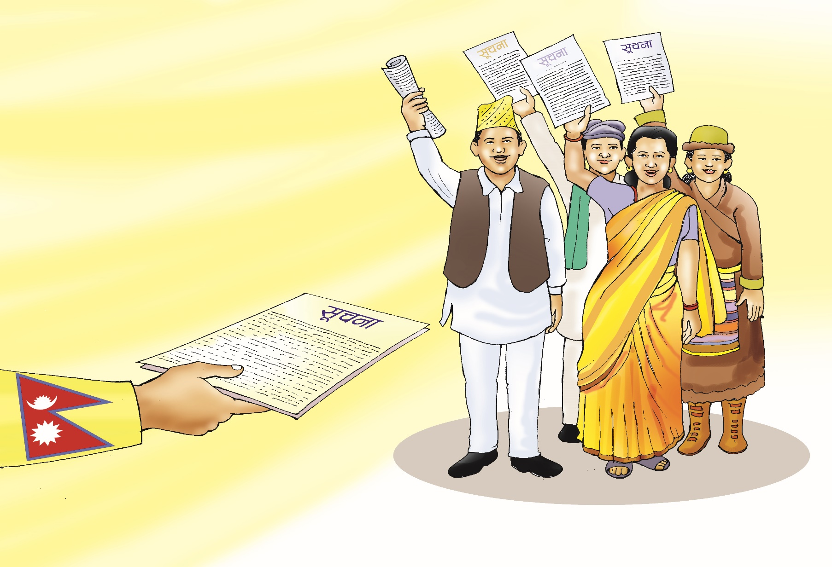
;"rgfsf] k|afxaf6 hgtfsf] hohosf/ kfO{G5 .

Slide 27
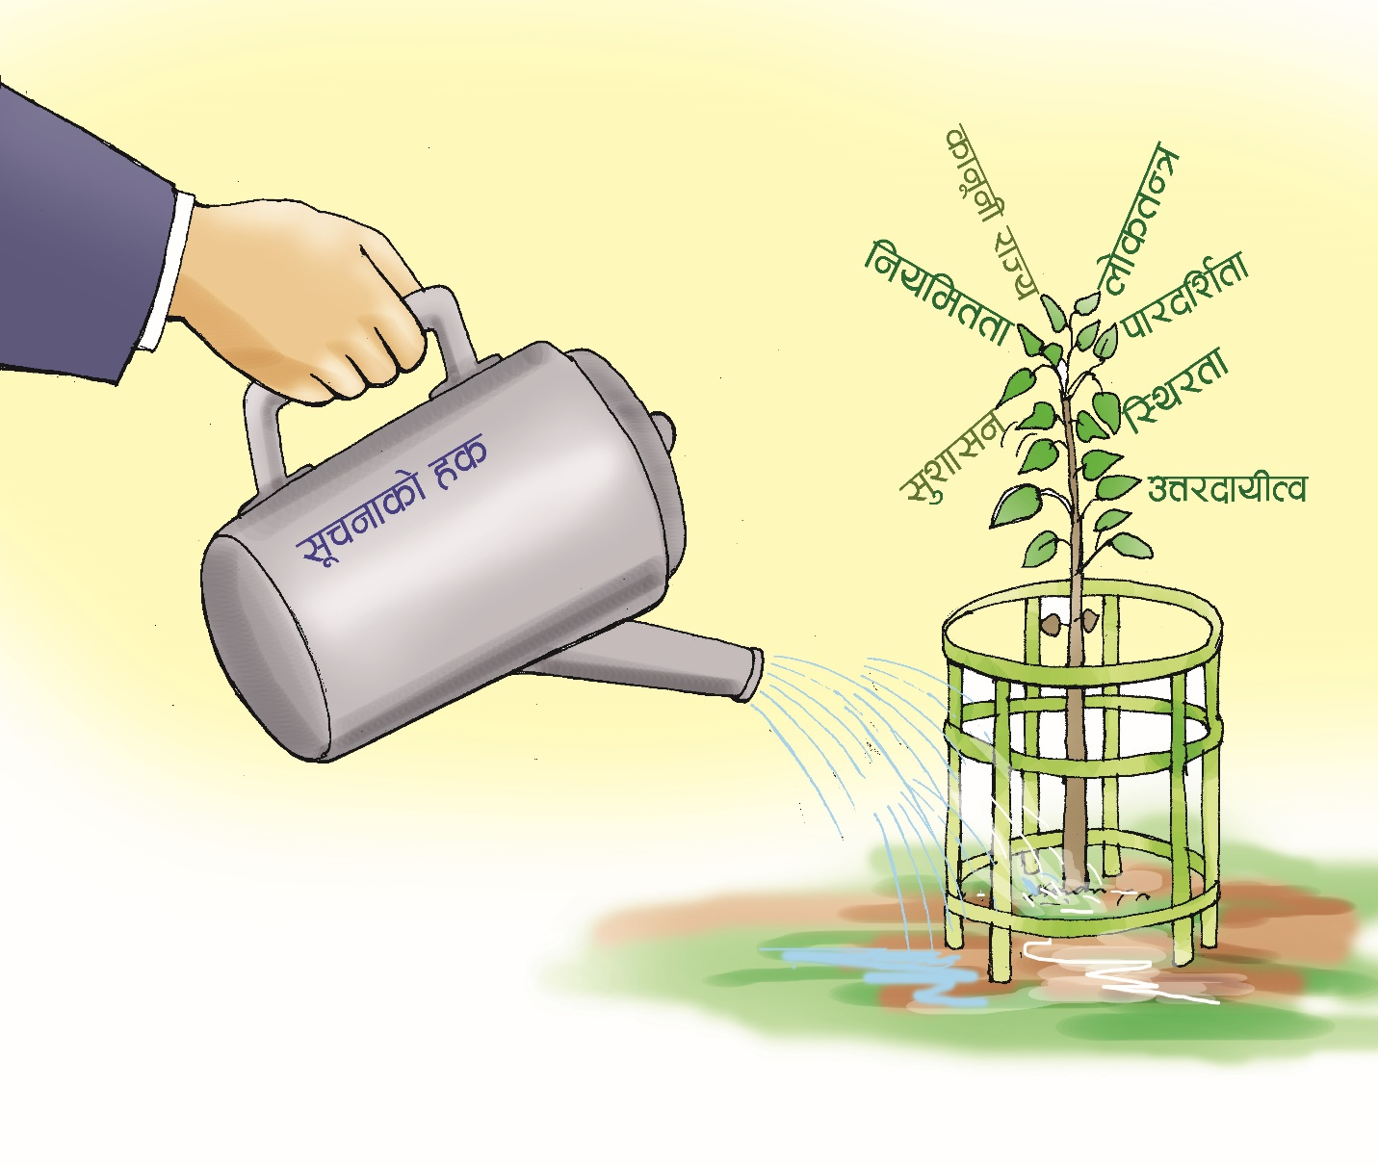
;"rgfsf] xs?kL hn l;+rgn] la?jf ;lk{G5 .

Slide 28
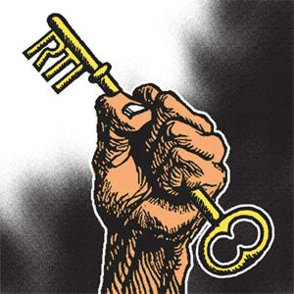
;"rgf gful/ssf] clwsf/ M ;'zf;g / ljsf;sf] cfwf/

Slide 29
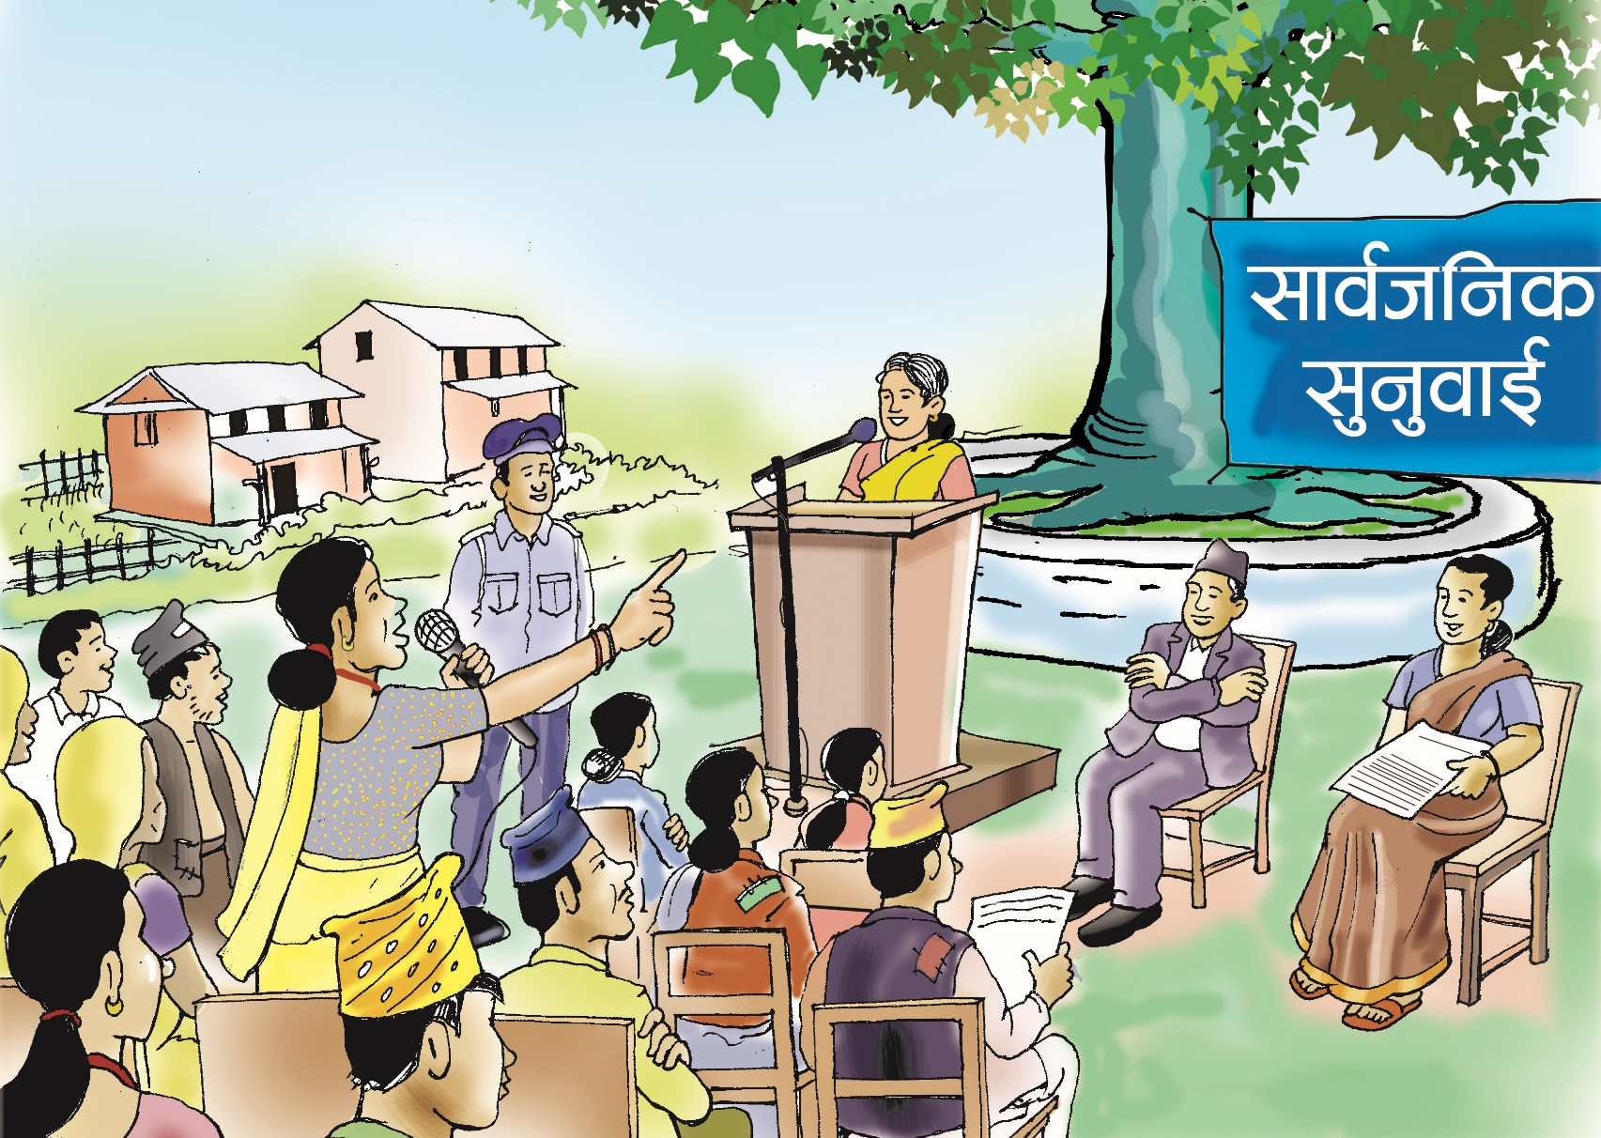
af:tljs ;"rgf lbg ws dfGg' kb}{g .

Slide 30
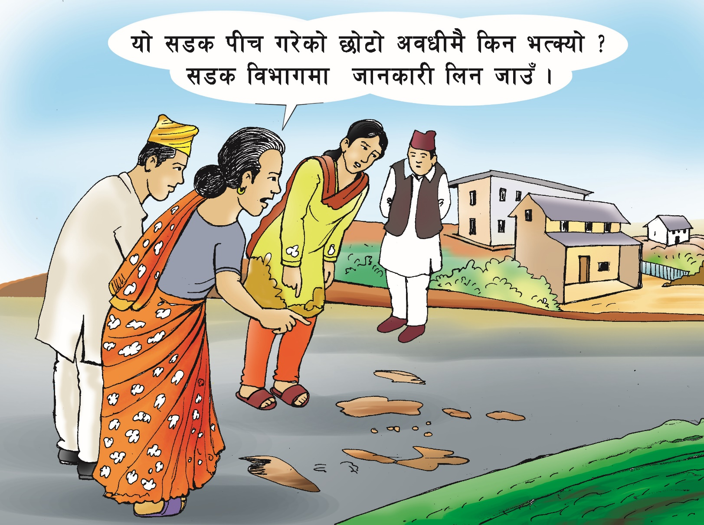
;"rgfsf] xs eg]sf] ;fj{hlgs sfo{sf] va/bf/L xf] .

Slide 31
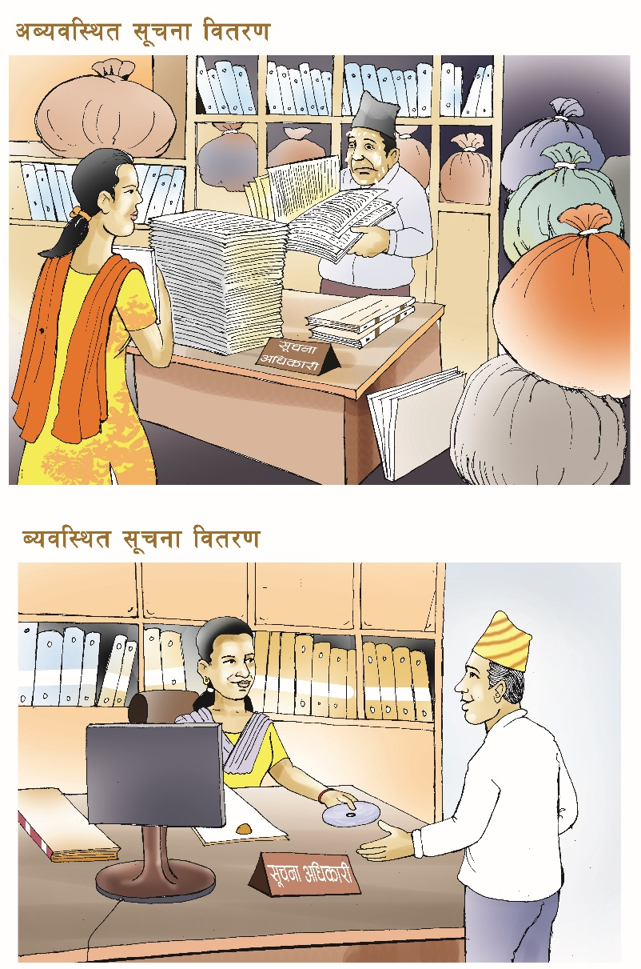
;"rgf Joal:yt x'g} k5{ .

Slide 32
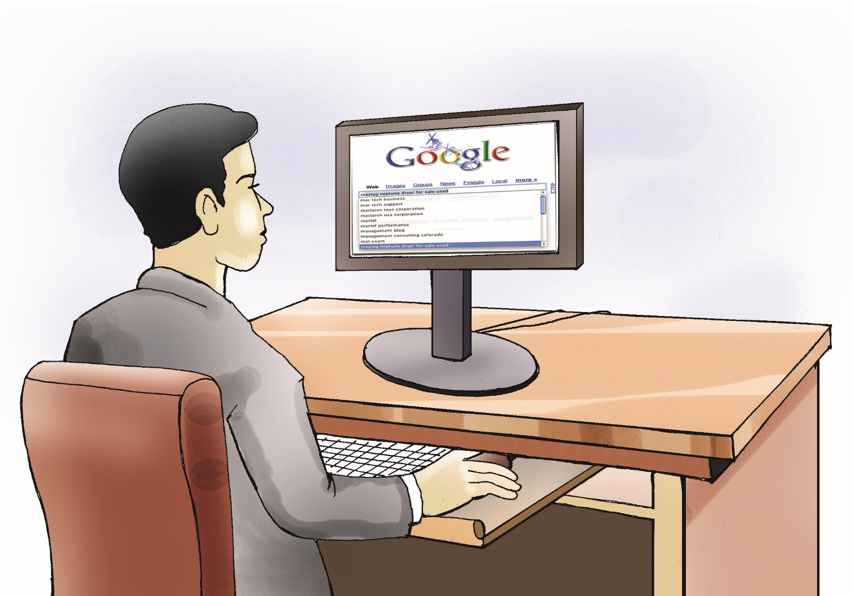
;"rgf b'?:t eP lbg ;lsG5 .

Slide 33
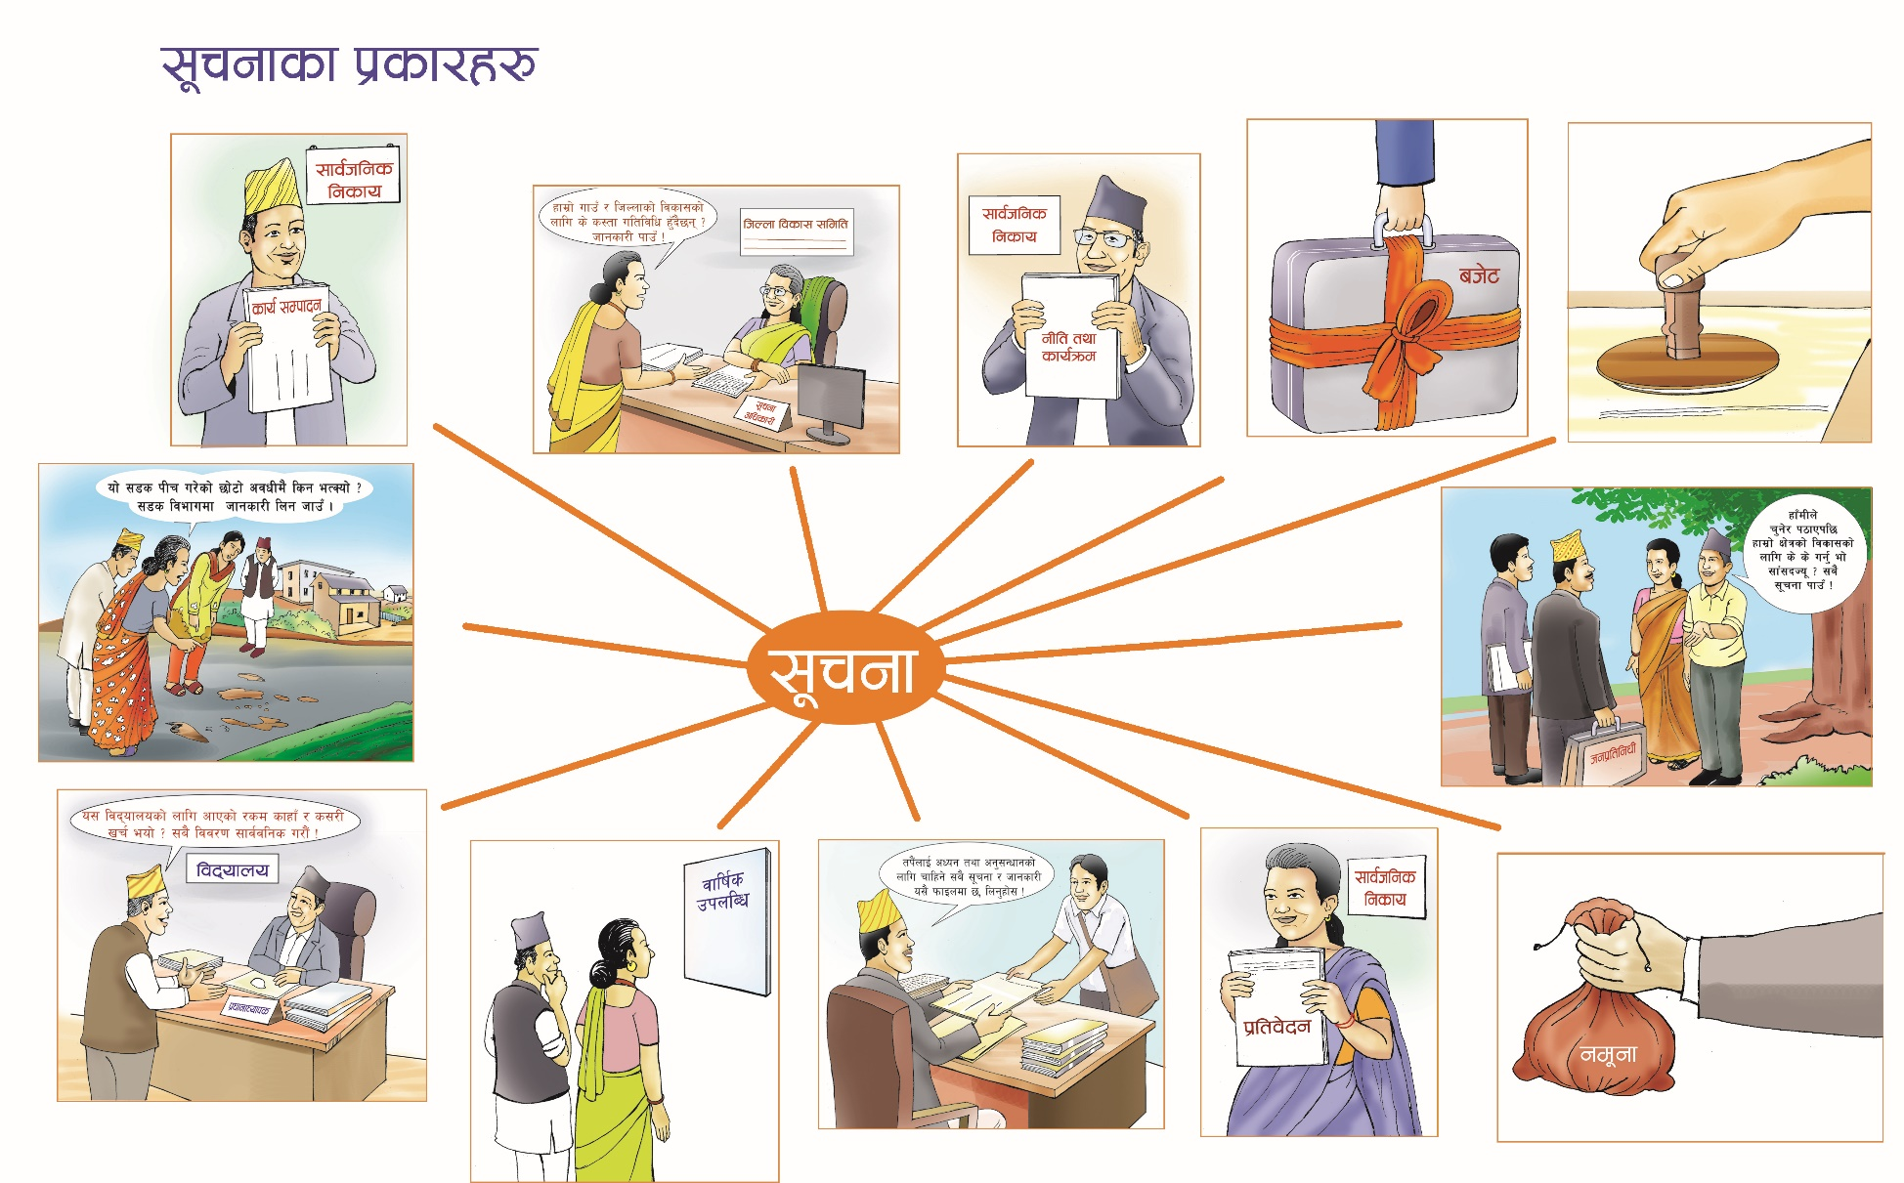
cg]s ;"rgf M cg]s gful/snfO{ lbg' k5{ .

Slide 34
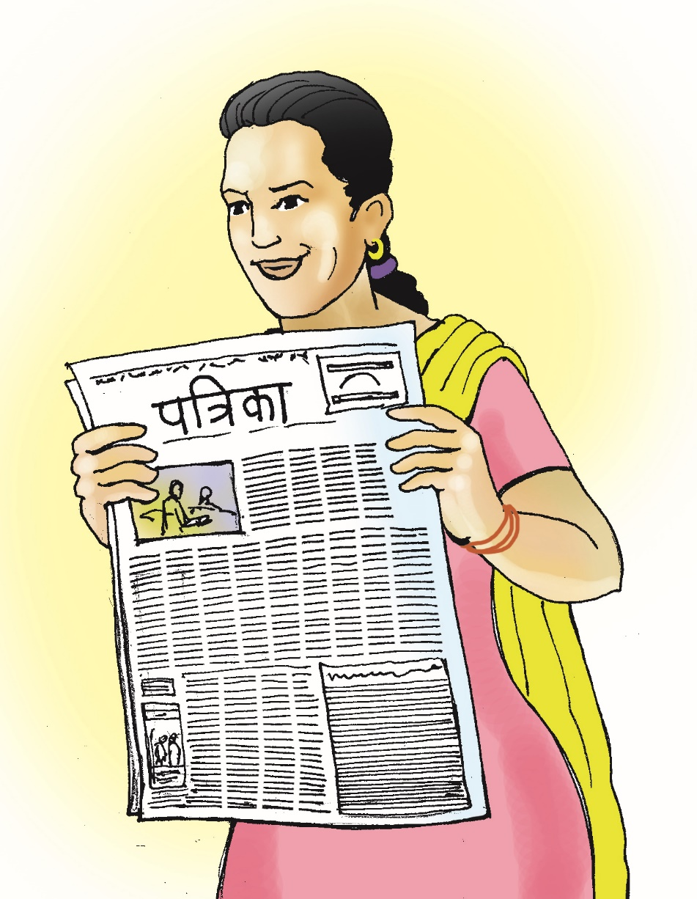
;fa{hlgs rf;f]sf] ;"rgf / ca;/ ;DaGwL ;"rgf gful/sn] rf+v dfg]/ cWoog u5{g .

Slide 35
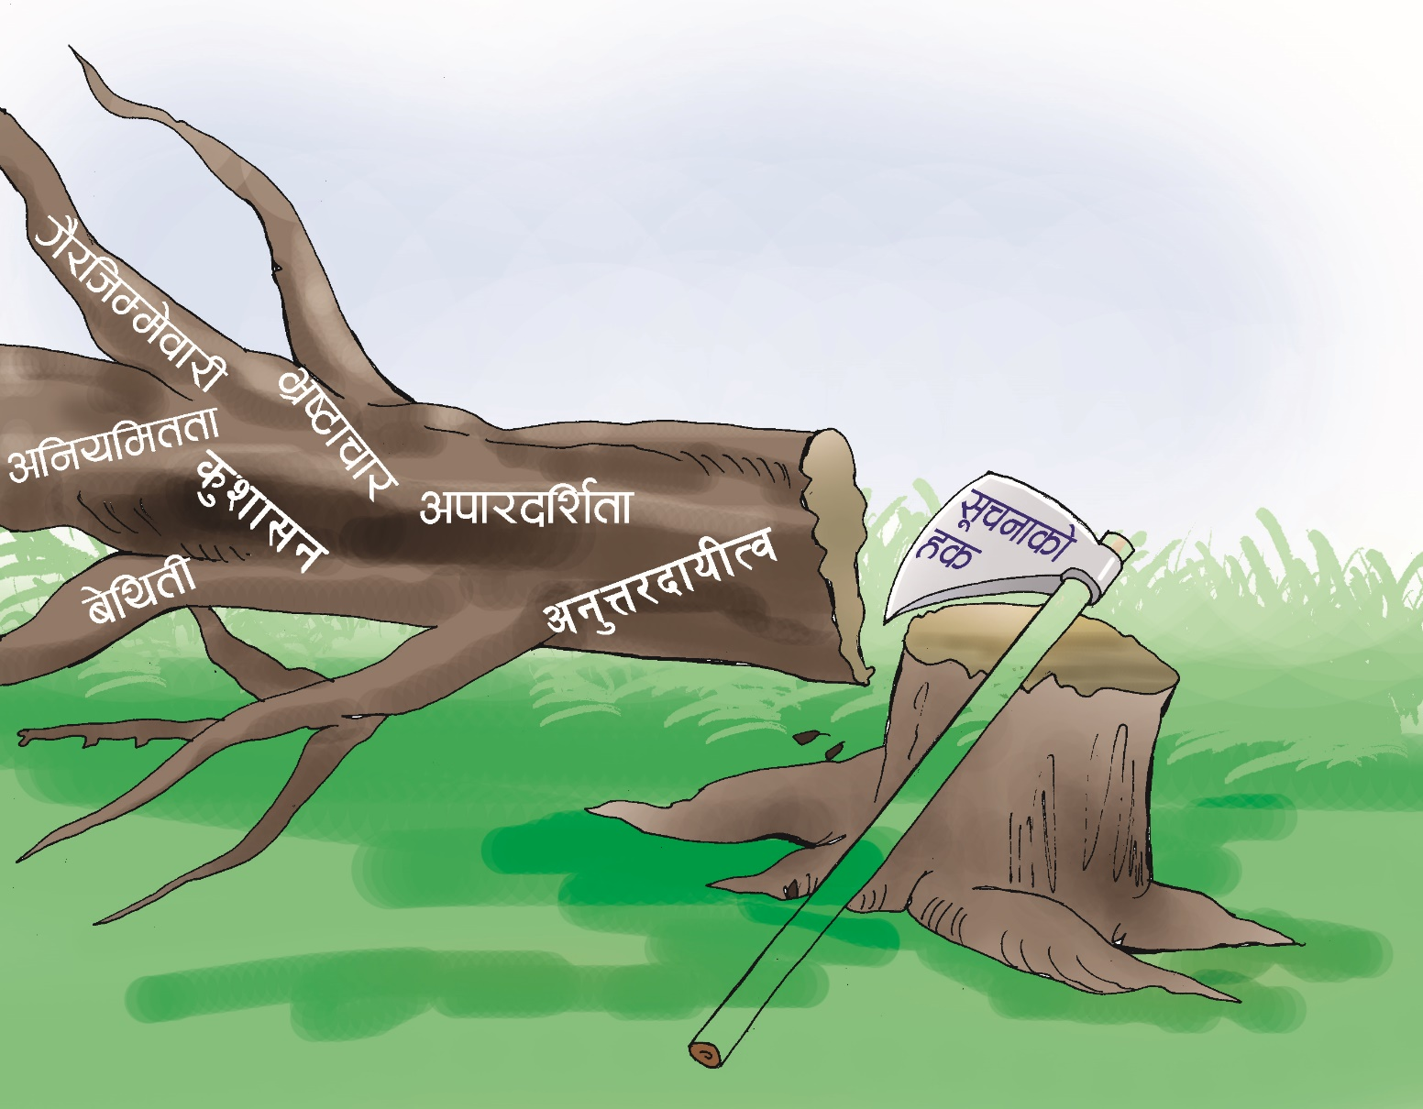
;"rgfsf] xs ljs[ltsf lj?4sf] cleofg xf] .

Slide 36
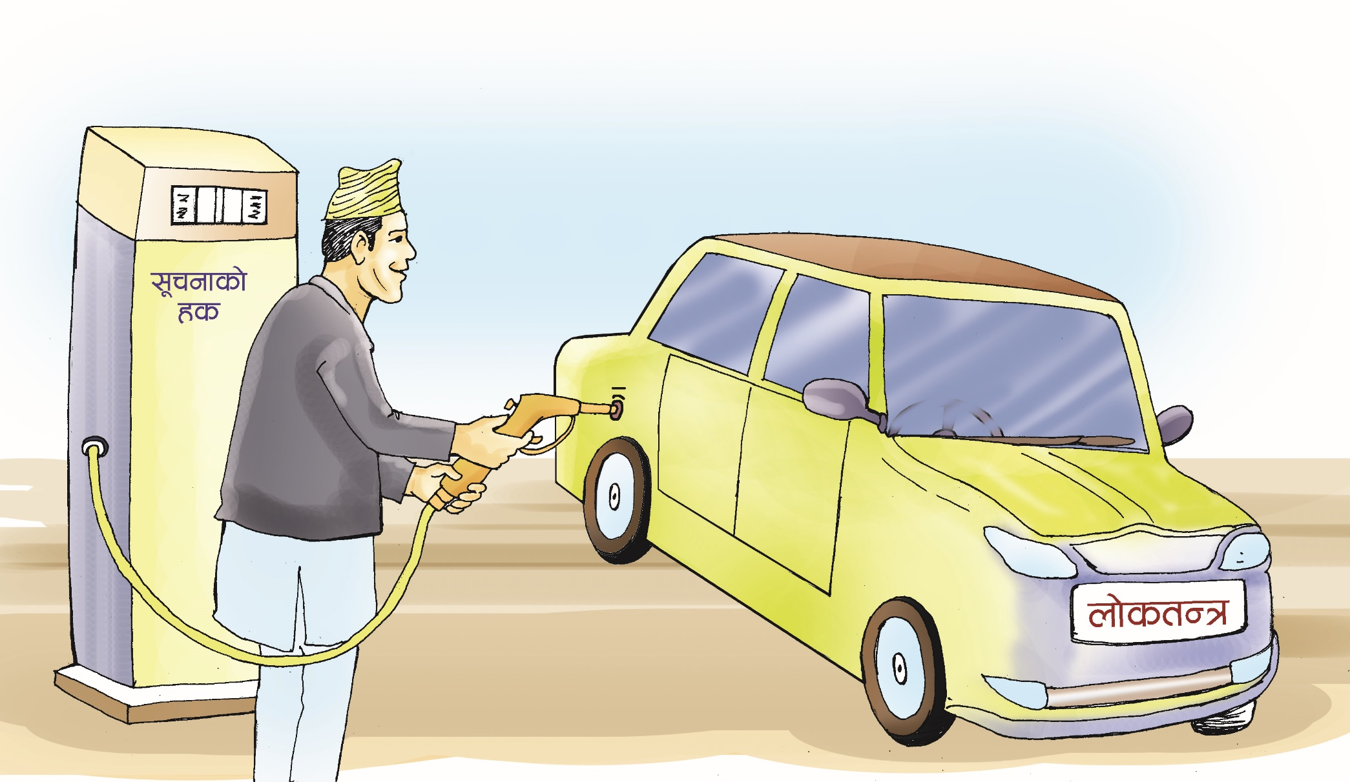
nf]stGq?kL df]6/ ;"rgfsf] xs?kL O{Gwgaf6 rN5 .

Slide 37
v'Nnf ;/sf/ ;fem]bf/L
Open Governmet Partnership

Slide 38
Open Government Partnership (OGP) M kl/ro
)= OGP /fd|f] ;/sf/ / c;n zf;g tof/ ug]{ Pp6f gofF laZj ;+u7g xf] .
)= ;g\ @)!! sf] ;]K6]Da/ @) df cd]l/sf / a|flhnsf] ;ls|otfdf laZjsf * b]z / ( gful/s ;+:yf ldn]/ OGP sf] :yfkgf ePsf] xf] .
)= OGP sf] d'Vo laz]iftf nf]stflGqs zf;gnfO{ ;'b[9 ug'{ / ;/sf/ tyf gful/s ;dfh aLr ;fem]bf/L ug'{ xf] .

Slide 39
OGP sf k|d'v sfo{ If]qx?
)= nf]stflGqs zf;sLo k4lt -Democractic Governance_ nfO{ Joaxf/df ;'lglZrt ug'{ .
)= zf;g Joj:yfdf kf/blz{tf / pQ/bfloTj a9fpg' .
)= gLlt lgdf{0fdf hgtfsf] ;xeflutf clea[l4 ug'{ .
)= zf;g ;+rfngdf hg;xeflutf -Public Participation_ Pj+ gful/s ;+nUgtf -Citizen Engagement_ sf] clea[l4 ug'{ .
)= ;"rgfsf] xs -Access to Information_
)= ;fa{hlgs ;]jf k|afx -Public Service Delivery_
)= ah]6 kf/blz{tf -Budget Transperency_
)= gful/s ;+nUgtf -Citizen Engagement_
)= ;';]nL ug]{ jf ;"rgf lbg]sf] ;+/If0f -Whistle blower protection_
)= bftf kf/blz{tf -Aid Transperency_

Slide 40
OGP sf] cGo dxTjk"0f{ sfo{ If]qx?
)= v'Nnf ;/sf/L tYofÍ -Open Government Data_
)= ;DklQ 3f]if0ff -Asset Disclosure_
)= :Jffy{ 3f]if0ff -Conflict of Interest _
)= ;+;bLo kf/blz{tf -Open Parliament_
)= k|x/L / ;fj{hlgs ;'/Iff lgsfosf] kf/blz{tf -Police and Security Agency's Transparency_
)= Goflos kf/blz{tf -Judicial Transparency_
)= pkef]Qmf ;+/If0f -Consumer Protection_
)= kf/bzL{ ;+rf/ dfWod -Media Transparency_

Slide 41
OGP sf] l;4fGtx?
zf;g Joa:yfdf gful/ssf] k|efjsf/L ;xeflutfsf] l;4fGt .
gful/s / ;/sf/ jLr ;xsfo{ / ;x–;[hgfsf] l;4fGt .
/fHo k|0ffnLdf ;dfj]zLs/0f / ljljwtfsf] l;4fGt .
;/sf/L sfo{sf] kf/blz{tf tyf hjfkmb]lxtfsf] l;4fGt .
v'nf ;/sf/L tYofÍsf] l;4fGt .
;fj{hlgs dxTjsf] ;"rgfsf] k|afx / k|of]usf] l;4fGt .
;"rgf tyf tYofÍdf kx'Fr / ;xhtfsf] l;4fGt .

Slide 42
ljZj ;Dd]ng, ;+u7gfTds 9f+rf

Slide 43
OGP ljZj ;Dd]ng
)= klxnf] ljZj ;Dd]ng, cd]l/ssf] jfl;ª\6g l8;Ldf eof] .
)= bf];|f] ljZj ;Dd]ng, a]nfotsf] n08gdf eof] .
)= t];|f] ljZj ;Dd]ng, d]lS;sf]sf] d]lS;sf] l;6Ldf ;g\ @)!% cS6f]j/ @* / @( df eof] .
)= rf}yf] ljZj ;Dd]ng, k|mfG;sf] k]l/;df ;g\ @)!^ sf] l8;]Dj/ &–( df eof] .
kfrf}+ ljZj ;Dd]ng, hlh{ofsf] l6aLln;Ldf ;g\ @)!* sf] h'nfO{ !&–!( df eof] .
5}7f}+ ljZj ;Dd]ng, Sofg8fsf] cf]6fafdf ;g\ @)!( sf] d] @(–#! df eof] .

Slide 44
OGP sf] ;+u7gfTds ;+/rgf
)= OGP sf] sfo{ ;+rfng ug{ ;lrjfno u7g ul/Psf] 5 .
)= b'O{ aif{sf nflu lgb]{zs ;ldlt -Streering Committee_ sf] rog x'G5 .
)= ljZj ;Dd]ngdf ;/sf/, gful/s ;dfh, k|fl1s hut / k|]zsf]
pkl:ylt x'g] ub{5 .
)= ;+u7g ;+rfngsf] sfo{sf/L kl/ifb\df ;/sf/x? / gful/s ;+u7gsf k|ltlglwx?sf] a/fj/ ;+Vofdf k|ltlglwTj x'G5 .
)= ;/sf/x? / gful/s ;+u7g b'j} tkm{af6 Ps Pshgf ;x cWoIf /xG5g\ .
)= lgb]{zs ;ldltdf ;/sf/x? / gful/s ;+u7gx?sf tkm{af6 !!–!! hgfsf] k|ltlglwTj /xG5 .
)= sfo{;d"xx? lgb]{zs ;ldlt dftxt /xG5g\ .

Slide 45
OGP cg'udgsf] tLg kIf
)= OGD ;lrjfnon] :jtGq k|ltj]bg lbg] -Independent Reporting Mecanism_ 5 . o;df ;/sf/x?sf k|ult, cg'ej / cj;/x? ;d]l6g] ub{5 .
)= gful/s ;+u7gx?n] As a watchdog sf] ?kdf sfd ub{5g\ .
)= ;/sf/n] cfkm\gf] sfdsf] :jo+ d"nofs+g -Self Assessment_ ub{5 .
OGP Pp6f :jo+;]jL ljZj d+r
)= of] Pp6f :j+o;]jL ljZj d+r xf] .
)= o;n] afWosf/L st{Jo l;h{gf ub}{g .
)= a? lg/Gt/ zf;sLo ;'wf/sf] lbzfdf cl3 a9\g] k|lta4tfnfO{ xf};nf / k|f]T;fxg k|fKt ug{ ;xh x'g]5 .
)= gful/s ;zlQms/0f / gful/s ;Fusf] ;fem]bf/Lsf] jftfj/0fnfO{ ;'b[9 agfO{ nf]stGqnfO{ cem ;dfj]zL / ;xeflutfd"ns t'Nofpg ;fem]bf/Laf6 ;dy{g / ;xof]u k|fKt x'g]5 .

Slide 46
OGP sf] ;b:otfsf] cfwf/x?
)= ;"rgfsf] xs -Access to Information_
)= ljQLo kf/blz{tf -Fiscal Transparency_
)= ;fj{hlgs kbflwsf/Lsf] ;DkQL ;fj{hlgsLs/0f -Public Officers Asset Disclosure_
)= gful/s ;xeflutf -Citizen Engagement_
oL $ cf]6f ;b:otfsf] cfwf/x? k|To]sdf $ k"0f{8\)sdf g]kfnn] ;"rgfsf] xs / lalQo kf/blz{tfdf $.$, ;fa{hlgs kbflwsf/Lsf] ;DkQL ;fa{hlgsLs/0fdf @ / gful/s ;xeflutfdf # u/L s"n !^ df !# c+s cyf{t\ *@ k|ltzt c+s k|fKt u/L ;b:otfsf] nflu cfaZos Go"gtd &% k|ltzt c+s eGbf a9L c+s xfl;n u/L ;b:otfsf nflu O{lGe6]zg n]6/ k|fKt u/]sf] 5 .

Slide 47
v'Nnf ;/sf/L tYofÍ
Open Government Data

Slide 48
OD sf] cf/De
cfkm"n] lt/]sf] s/ dWo] slt /sd ;8s aQLdf jf SofG;/sf] cg';Gwfgdf vr{ eof] xf]nf <
cfkm\gf] 3/af6 sfof{no hfFbf af6f]df kg]{ ;'/lIft / dgf]/d k|fs[lts b[io ePsf] ;fO{sn dfu{ s'g xf]nf <
cfkm"n] km]/]sf] ;f; -jfo"_ sf] u'0f:t/ s] 5 <
cfkm\gf] a;fO{sf] cf;kf;df pQd sfd ug]{ df}sf sxfF pknAw 5 <
xfdLsxfF k|lt JolQm kmnkm"nsf] af]6 slt cf]6f k5{ xf]nf < nufotsf k|Zgsf] pQ/ kfpg OGD sf] cf/De ul/Psf] xf] .

Slide 49
v'Nnf 8f6fsf] nfeM 8]gdfs{, g]b/Nof08 / cd]l/sfsf] pbfx/0f
8]gdfs{sL Ps dlxnfn] findtoilet.dk gfds j]j;fO{6 lgdf{0f ul/g .
h:n] ;a} ;fj{hlgs zf}rfnosf] hfgsf/L lbof] .
o;af6 Anf8/df ;d:of ePsfx? klg lgw{Ss;Fu 3'dlkm/ ug{ ;Sg] eP .
g]b/Nof08df Vervuilingsalarm.nt gfds ;]jfn] jfo' u'0f:t/sf] hfgsf/L lbG5 .
Go"of]s{df s'g s'g kfs{df s's'/ 8'nfpg kfO{G5 eGg] ;"rgf lbg] Pk ag]sf] 5 .

Slide 50
v'Nnf 8f6fsf] ;/sf/L lgsfodf nfe
g]b/Nof08sf] lzIff dGqfnon] cfkm\gf ;a} 8f6f cgnfO{gdf /fVof] .
To;kl5 k|Zg ;f]Wg]sf] ;+Vofdf sdL cfof] .
h:n] ubf{ sfo{ef/ s6f}lt eof], vr{df sdL cfof] .
;fy} sd{rf/LnfO{ s'g 8f6f sxfF 5 egL hjfkm lbg ;lhnf] eof] .
8r ;f+:s[lts ;Dkbf ljefun] klg cfkm\gf 8f6f k|sflzt u/]sf] 5 .
ljlsldl8of h:tf ;d"xn] sfdnfO{ k|efjsf/Ltf lbg ;3fPsf 5g\ .

Slide 51
v'Nnf 8f6fsf] :jf:Yo If]qdf nfe
!( cf}F ztfAbLdf n08gdf x}hf km}lnof] .
8f= :gf]n] d[To'sf] 8f6f / kfgLsf] d'xfgsf] 8f6f lnP .
o;af6 vfg]kfgL, k|b'{if0f / x}hfsf] ;DaGw kQf nufP .
To:sf] cfwf/df n08gdf 9n k|0ffnLdf ;'wf/ ul/of] .
o;af6 cfd hgtfsf] :jf:Yodf a[xt\ ;'wf/ cfof] .

Slide 52
g]kfndf OD sf] k|of]usf] pbfx/0f
cy{ dGqfnosf] ;xfotf Joj:yfkg d+rn] ;"rgf lbG5 .
ljsf; ;xfotfx? PS;]n 9fFrfdf 5g\ .
;xfotfsf] If]q, ldlt, ljlQo k|lta4tf, e'QmfgL, kl/of]hgfsf ;"rgf 5g\ .
bftfn] klg ;"rgf lbg ;3fpF5g\ .
of] cgnfO{g 8\of;af]8{df b]vfpg jf PS;]ndf 8fpgnf]8 ug{ ldN5 .
www.amis.mof.gov.np

Slide 53
g]kfndf OD sf] k|of]usf] pbfx/0f
sDkgL /lhi6f/ sfof{nodf btf{ ePsf ;+:yfx?sf] cfwf/e"t 8f6f, sDkgLsf] gfd, pd]/ / sfof{no /x]sf] lhNnf nufotsf ;"rgf pknAw 5 .
oL 8f6f CSV / XMC 9fFrfdf pknAw 5g\ .
www.ocr.gov.np

Slide 54
g]kfndf OD sf] k|of]usf] pbfx/0f
sf7df8f}+ lnleË NofA;n] e"sDksf avt lgdf{0f u/]sf] .
OpenStreetMap / Quakemap.org gfds j]j kf]6{n lgdf{0f eof] .
o; kf]6{nn] e"sDksf sf/0f hLjg d/0fsf] bf];fFwdf /x]sfnfO{ p4f/ ug{ / /fxt k'¥ofpg d2t u¥of] .
ljz]ifu/L p4f/df g]kfnL ;]gf, g]kfn k|x/L, ;z:q k|x/L an, :jo+ ;]js, bft[ lgsfo nufotn] o:sf] k|of]u u/] .
o:df sl/a ( xhf/ gSzf+sg tof/ e} k|of]u eP .

Slide 55
g]kfndf OD sf] k|of]usf] pbfx/0f
cf]kg g]kfnsf] v'Nnf 8f6f kf]6{n
;/sf/ / u}/ ;/sf/L lgsfoaf6 k|fKt 8f6fx?nfO{ v'Nnf 8f6fdf pknAw u/fpg] .
o:n] lkl8Pkm 8f6fnfO{ v'Nnf 8f6fdf pknAw u/fpF5 .
www.data.opennepal.net

Slide 56
g]kfndf OD sf] k|of]usf] pbfx/0f
sf]8 km/ g]kfnsf] g]kfn Dofk
of] Pp6f kl/of]hgf xf], h:n] l8lh6n ;fIf/tf a9fpF5 .
o:sf] Dofkdf lhNnf, gu/, ufpF:t/sf ljleGg 8f6fx? pknAw 5g\ .
oL 8f6f 8fpgnf]8 ug{ ldN5 .
www.nepalmap.org

Slide 57
g]kfndf OD sf] k|of]usf] pbfx/0f
ljsf; pBdLsf] g]kfn Og 8f6f
of] Pp6f gjLgtd\ ;fdflhs s]Gb| xf] .
o:n] ;g\ !(%) b]lv 8f6f pknAw u/fpFb} cfPsf] 5 .
;a} If]qsf 8f6fnfO{ PsLs[t ?kdf t'ngf ug{ ldNg] u/L ;xh?kdf 8f6f pknAw u/fpF5 .
8f6fsf] dfWodaf6 cGt/ls|of klg ug{ ldN5 .
www.nepalindata.com

Slide 58
g]kfndf OD sf] k|of]usf] pbfx/0f
of]Ë OGgf]e];gsf] e"sDk k|ltls|of kf]6{n .
clk|n @% sf] e"sDk / To;kl5sf ultljlwnfO{ o:n] k5\ofpF5 .
o:n] cGt/f{li6«o ;xfotf kf/blz{ kxn -IATI_ ;Fu ;fem]bf/Ldf sfd u5{ .
/fxt, k'glg{df{0f, /fxtsf] 9fFrf nufotsf tYofÍ pknAw 5 .
www.earthquake.opennepal.net

Slide 59
g]kfndf OD sf] k|of]usf] pbfx/0f
sf7df8f}+ dxfgu/kflnsfsf] kf/blz{tf / gful/s ;xeflutf kmf]/d
sfdgkf j8f g+= & sf 8f6fx? pknAw u/fpg] .
ah]6, kl/of]hgf, hg;f+lvs 8f6f pknAw 5g\ .
oL 8f6fx? PS;]n 9fFrfdf 8fpgnf]8 ug{ ;lsG5 .
www.modelug.com

Slide 60
g]kfndf OD sf] k|of]usf] pbfx/0f
cf]kg gn]h g]kfnsf] On]S;g g]kfn kf]6{n
of] Pp6f s|fp8;f];{ v'Nnf kf]6{n xf] .
o:df :yfgLo lgjf{rgsf] 8f6f Ps} 7fpFdf b]Vg ;lsG5 .
oL 8f6f k'gk|{of]uof]Uo 5g\ .
kf]6{ndf cGt/ls|ofTds b[io / OGkmf]u|flkmS; ;dfj]z 5 .
o;af6 ;+3Lo /fHo ljefhg / :yfgLo lgjf{rgsf] lrgf/L xfl;n ug{ ;lsG5 .
www.electionnepal.org

Slide 61
cfTd ljsf; / ;sf/fTds ;f]rsf ;"qx?
s[i0fxl/ af:sf]6f
k"j{ k|d'v ;"rgf cfo'Qm tyf g]kfn ;/sf/sf] k"a{ ;lra
khbaskota1@gmail.com 9841350280

Slide 62
!= l;sfO{ lalw
lgis[otfnfO{ ;ls|otfdf ?kfGtl/t ug]{ ;"qx?

Slide 63
l;Sg] / l;sfpg] tl/sf
lzIffdgf]ljb\ ?;f]sf cg';f/ cg'ejsf cfwf/df l;lsG5 .
s]6fs]6LnfO{ k|s[lt;Fu /Dg lbFbf l56f] l;Sb5g\ .
pgn] Jofs 6' g]r/ eGg] k':tsdf o:sf] JofVof u/]sf 5g\ .
kfgLn] ?lemG5 . cfuf]n] kf]N5 eGg] s'/f l;sfP/ eGbf cg'ej u/]/ l56f] l;lsG5 .
csf{ lzIffdgf]ljb\ Kofenjn] uNtLaf6 k|efjsf/L l;sfO{ x'g] cawf/0ff /fv]sf 5g\ .

Slide 64
l;Sg] / l;sfpg] tl/sf
lzIffljb\ lsDann] dflg;n] cGt/b[li6af6 l;S5 eGg' ePsf] 5 .
lzIffljb\ oªn] k|]/0ffn] dflg;n] l;Sg] s'/f atfpg' ePsf] 5 .
Pln; s|f]n] klg cfGtl/s k|]/0ffaf6} dflg;n] l;Sg] s'/f atfpg' ePsf] 5 .
lzIffljb\ k]:tfnf]hLn] l;Sg] JolQmsf] hfu?stfn] dfq} l;Sg ;lsg] s'/f atfpg' ePsf] 5 .
afGb'/fn] eg] lzIfs÷k|lzIfssf] /f]ndf]8nkgaf6 l;sfO{ k|efjsf/L x'g] s'/f agfpg' ePsf] 5 .

Slide 65
l;Sg] / l;sfpg] If]qx¿
1fg (Knowledge)
;Lk (Skills)
clea[lQ (Attitude)
Joaxf/ (Behavior)

Slide 66
;Lk÷1fg lbg] t/Lsf
k9]sf] s'/f lal;{G5
b]v]sf] s'/f ;+lemG5
u/]sf] s'/f hflgG5
ub}{ u/] afgL k5{ .
Habit comes from habit.
1fg (Learning Skills)

Slide 67
s;/L l;Sg] <
lbdfv
x[bo
xft rnfP/, l;Sg] .

Slide 68
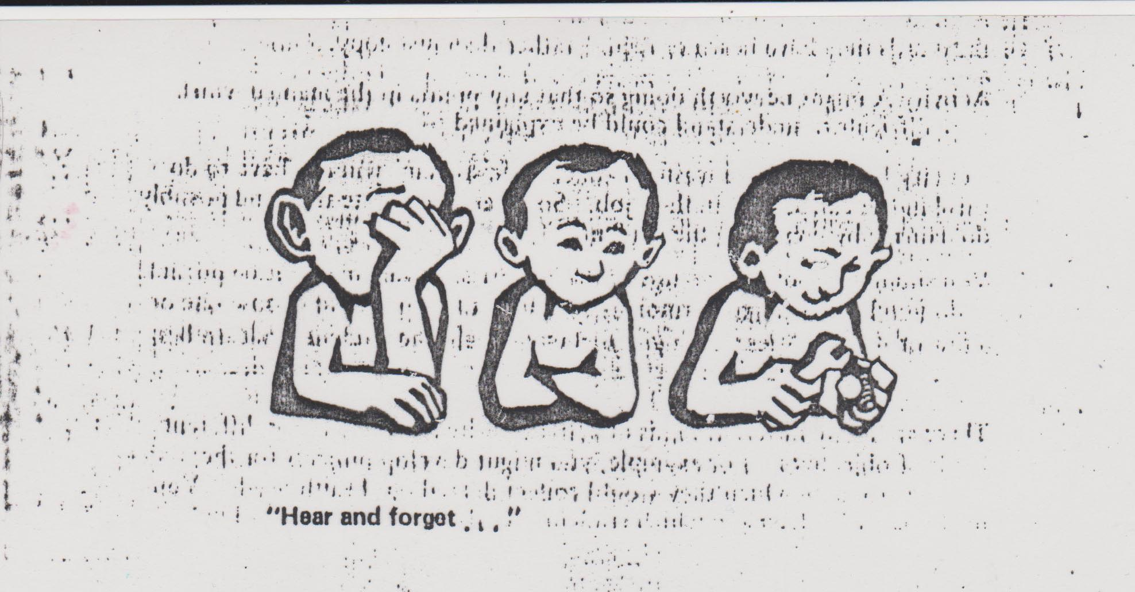

Slide 69
s] slt l;Sg h?/L 5 <
Required Competence - Actual Competence = Learning

Slide 70
dflg;sf] k|sf/
hf] p cfkm" hfGb}g / hflGbg eGg] klg hfGb}g
p d'v{ xf], To;nfO{ 5'6\ofp .
hf] p cfkm" hfGb}g, t/ hflGbg eGg] hfGb5
p ;fwf/0f xf], To;nfO{ l;sfp .
hf] p cfkm" hfGb5 t/ hfGb5' eGg] hfGb}g
p ;'if'Kt xf], To;nfO{ Ao'emfp .
hf] p cfkm" hfGb5 / hfGb5' eGg] hfGb5
p 1fgL xf], To;nfO{ k5\ofp .

Slide 71
@= km/s9+usf] l;sfO{
k9]/, hfg]/ k'Ub}g, ug'{k5{ M n'uf nufpg] !$ lalw

Slide 72
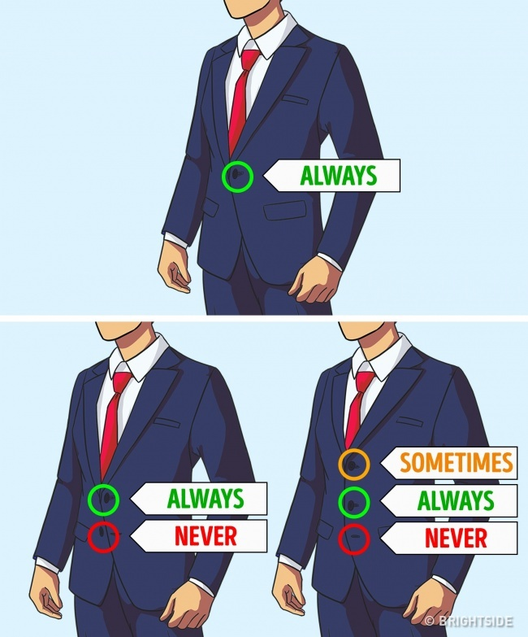
1. The middle button on a jacket should always be closed. The upper one depends on your mood. The lower one should never be closed.

Slide 73
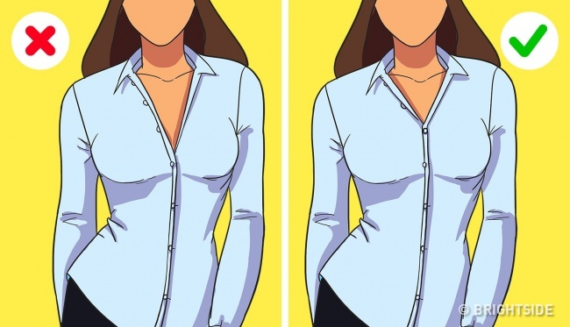
2. When you are wearing a shirt or a blouse, you can unbutton no more than 2 buttons.

Slide 74
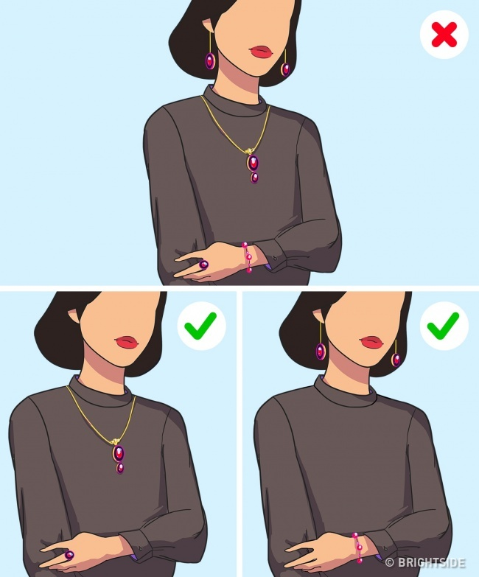
3. Wear earrings that match your bracelet and a necklace that goes well with your ring. 3 or 4 things in one look is too much.

Slide 75
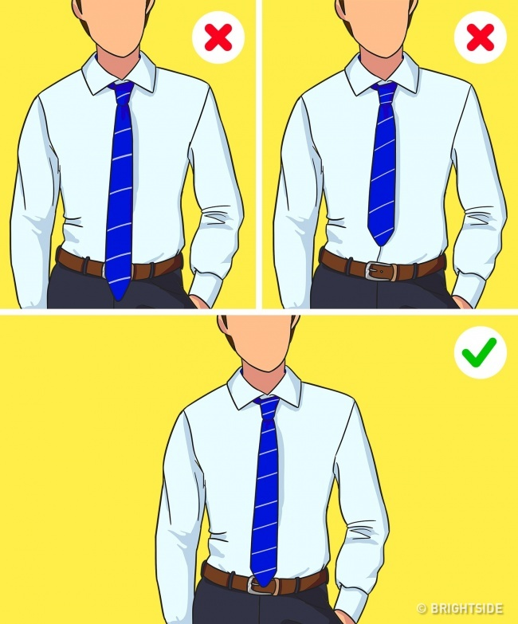
4. The tip of your tie should reach your waist and cross it just a little.

Slide 76
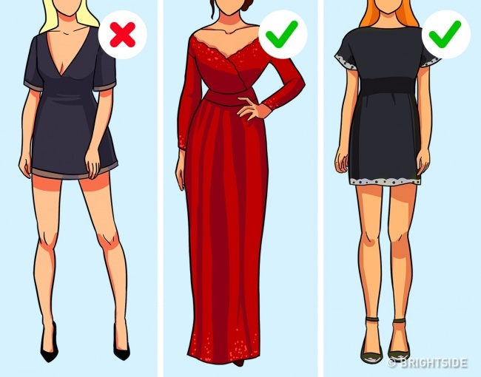
5. Opt for either a miniskirt or cleavage. Both at once look too vulgar.

Slide 77
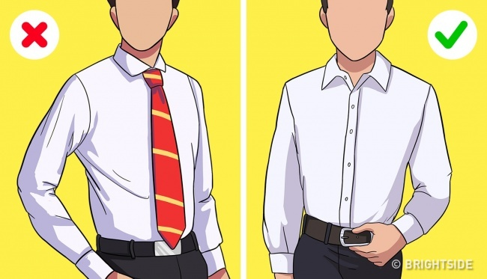
6. If you are wearing a shirt without a jacket, you don’t need a tie.

Slide 78
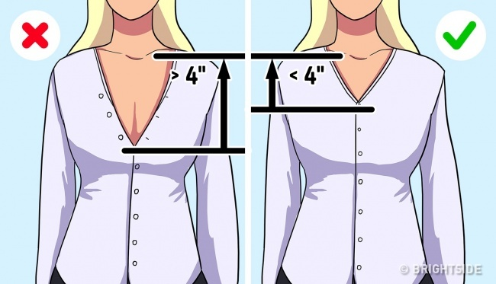
7. Your office shirt cleavage should not be deeper than 4″ from your collarbone.

Slide 79
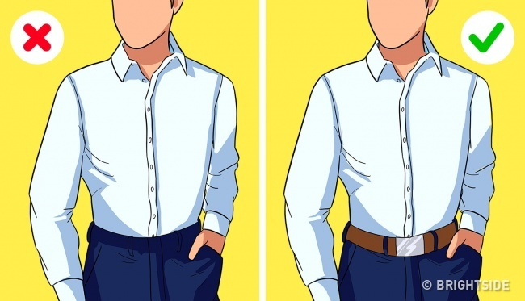
8. If you tucked in your shirt, you should wear a belt.

Slide 80
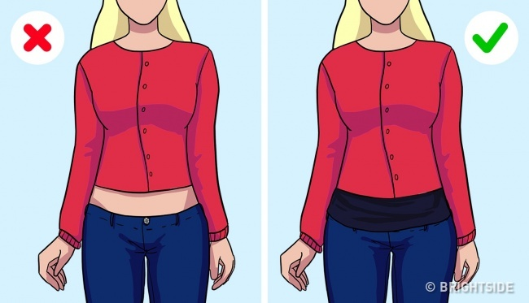
9. Your naked skin should not be seen between your cardigan and your jeans. Wear a top if necessary.

Slide 81
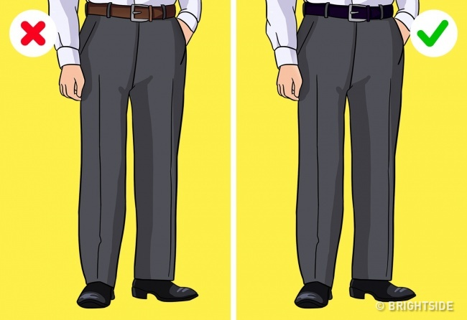
10. Your belt should be the same color as your shoes.

Slide 82
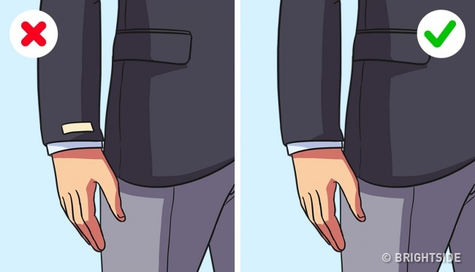
11. All visible tags on clothes should be cut off.

Slide 83
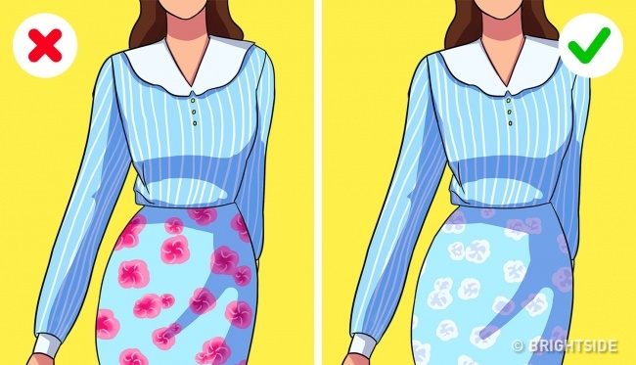
12. Don’t wear too many prints. You can wear 2 different prints of the same color or 2 coordinating prints of different sizes.

Slide 84
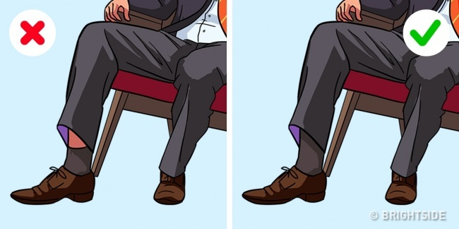
13. Your socks should be long enough that your naked legs aren’t seen when you are sitting.

Slide 85
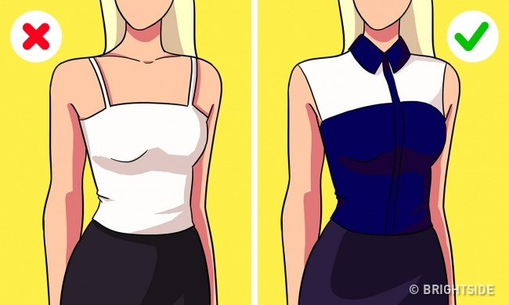
14. An office blouse without sleeves should cover your shoulders. “Spaghetti” straps are not okay in formal situations.

Slide 86
#= :jpTk|]/0ffsf l;4fGtx?
lx8]kl5 uGtJodf k'luG5 M ls|ofzLntf g} ;kmntfsf] Bf]ts

Slide 87
JolQmTjsf] z'?jft
xhf/f}F dfO{nsf] ofqf klxnf] kfO{nfaf6 cf/De x'G5 .
ljxfg x]/]/ lbgsf] cg'dfg ug{ ;lsG5 .
v'§f b]Vb}df s:tf] gflRng eGg] cg'dfg ug{ ;lsG5 .
dflg; cfpFbfsf] klxrfg n'ufn] atfpF5 .
alQ;} nIf0fn] o'Qm x'g'k5{ .

Slide 88
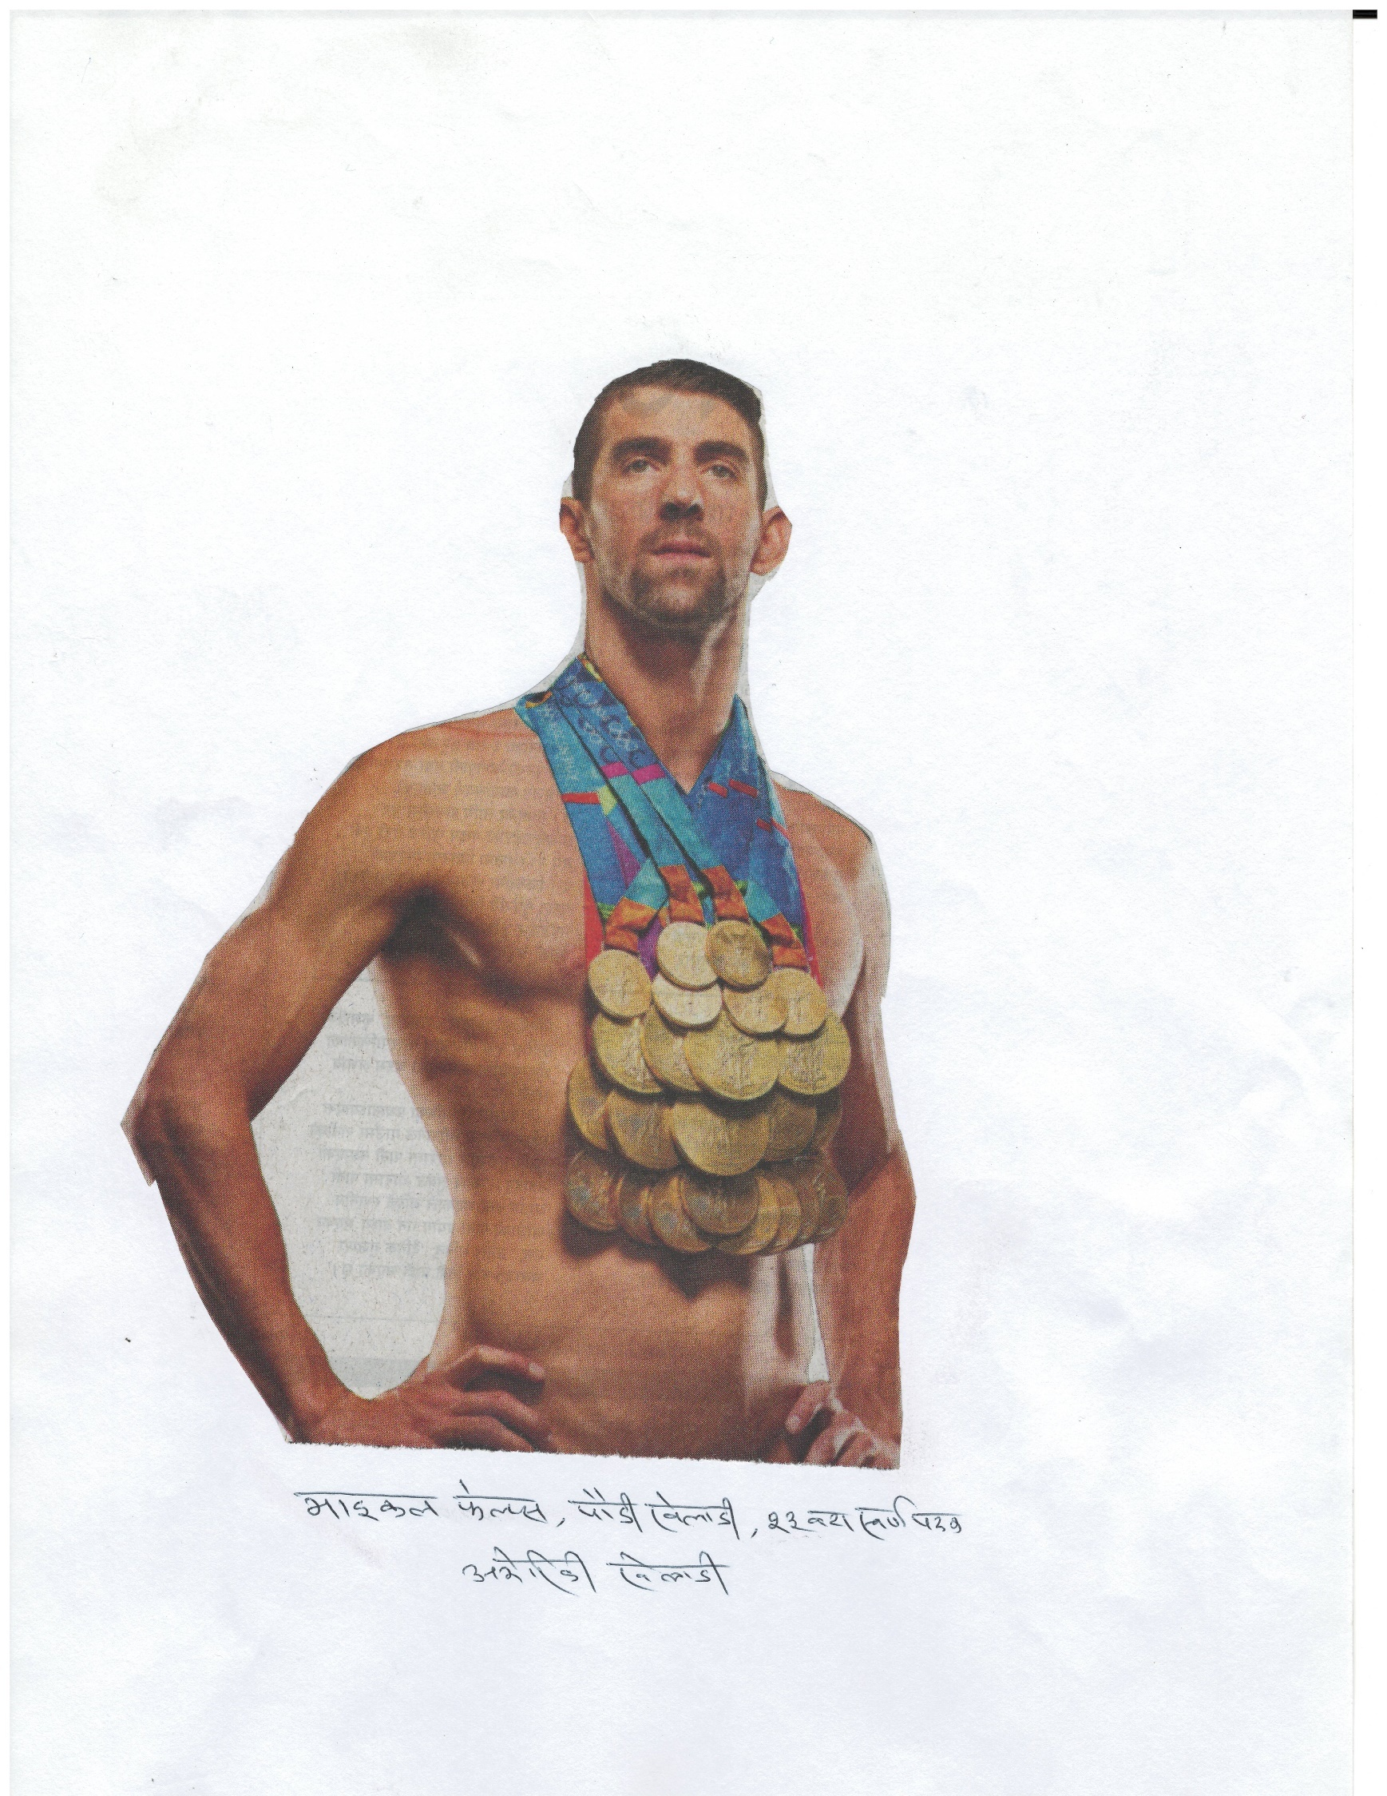
P2]Zo s] lng' p8L 5'g' rGb| Ps .

Slide 89
;+ut / ;f]rsf] kmn
;+utsf] kmn M
Pp6f ;'uf c;n af]Ng] .
csf]{ ;'uf v/fa af]Ng] .
;f]r cg';f/sf] kl/0ffd M
hf]uL–dlxnfsf] s'enf] lrtfpg] .
dlxnf–hf]uLsf] enf] lrtfpg] .

Slide 90
dfgj :jefj M /fd|f] / g/fd|f]
/fd|f :jefj M
Compromising
Summarizing
Proposing
Brining-in
g/fd|f :jefj M
Defending
Dictating
Attracting
Obstructing

Slide 91
s'g} sfd ug]{ ls gug]{ < r"tf}+ltsf] ;fdgf ug]{ ls gug]{ <
dxfg\ bf;{lgs ;'s/ftsf] Ps lzio b'lawfdf k/] . pgsf] b'lawf laafx u/f}+ ls gu/f}+ eGg] lyof] . cGTodf cf6 u/]/ cfk\mgf u'? ;'s/ft ;dIf k'u]/ ;Nnfx dfu] .
u'?b]a d b'lawfdf k/], laafx u/f}+ ls gu/f}+ <
;'s/ftn] s'g} lanDa gu/L laafx u/ eg]/ ;'emfa lbP .
lzion] cfk\mgf] dgdf /x]sf] b'lawf k|i6 kfb}{ k|Zg u/] . t/, xh'/sf] a}aflxs hLjg t ;kmn ePg, d s;/L 9'Ss eP/ laafx u/f}= <
;'s/ftn] eg] clwsf+z laafx u/]/ ;'vL v';L ePsf 5g\, ltdL klg ;f]xL leq kg]{5f}+ .
lzion] tTsfn} k|Zg u/], xh'/sf] h:t} a}aflxs hLjg c;kmn eof] eg] lg <
;'s/ftn] klg tTsfn} hjfkm lbP, ;f] ca:yfdf ltdL klg d h:t} bfz{lgs aGg]5f}+ . cyf{t\ laafx u/]/ ;'vL x'gklg ;S5f}+, To:s} sf/0f csf]{ ;kmntf klg xfl;n ug{ ;S5f}+ . r"gf}+ltnfO{ :jLsf/ ug'{ dfga st{Jo xf] .

Slide 92
;dfh / a[4f
Pp6f ufpdf leif0f cfunfuL eof] .
dflg;x? cfuf] lgefpg yfn] .
Pshgf a[4f ;lsg;sL afN6Lgsf] ;§f lunf;df kfgL lnP/ cfuf] lgefpb} lyO{g .
Pp6f cN5L / xNsf la/gdL ePsf] o'asn] of] b[io b]v]/ ;f]Wof] .
a[4fn] elgg kl5 o:sf] ;dLIff x'bf o; a[4fn] cfuf] nufPsL xf]O{gg\, cfuf] lgefpg nfluk/]sL lyO{g eGg] ;"rLdf d]/f] gfd kg]{5 .
s]6f]sf] xf]; v'Nof] / cfuf] lgefpg bf}l8of] .

Slide 93
s6' ;To
;'s]sf] k/fndf wfg kmnfpg ;lsFb}g .
;a} km"n km"Nb}df jf:gf rNb}g ,
hfO{ / rd]nL km"Nbf jf:gf rN5,
t/ pGo"F / v/ km"Nbf jf:gf rNb}g .

Slide 94
/fd|/L ;f}rf}F
la/fnf] sfnf] xf];\ jf ;]tf] xf];\, d';f dfg'{k5{ .
v'§f cg';f/ h'Qf agfpg] xf] . h'Qf cg';f/ v'§f sf6\g ;lsGg .
uNtL To;}n] ub{}g, h;n] slxn] s]xL u/]sf] 5}g .

Slide 95
k|]/0ff JolQmTj
ln+sg ===
uf]sL{ ===
sflnbf; ===
xjf6{ Snfs
yf]d; PNjf Pl8zg
efq[xl/ M
rf/ k|sf/sf dflg; .

Slide 96
cfljisf/
sDKo"6/ – 6'l/Ë
6]lnkmf]g – u|fXda]n
xjfO{ hxfh – /fO{6 a|b;{
l8lh6n Sofd]/f – :6]e]g
Pl6Pd – jf/f]g
/]l8of] – dfsf]{gL

Slide 97
oL ;To–tYo s'/f x'g\ .
lxdfnaf6 z'? ePsf] vf]nf af6f] g;f]wL lx8\bf klg ;d'Gb|df k'U5 .
kf]v/Ldf xfd kmfNg] ;a} dflg; db}{gg\, kf}8g ghfGg] dfq} d[To"sf] d'vdf k'U5g\ .
?vn] h;/L aif]{gL kft km]5{, ;f]xL l/tn] xfdLn] cfkm"nfO{ ;dofg's'n abNg' k5{ .
vf6af6 v;'nf ls eGg] 8/ 5 eg] e'O{df ;'Tg' a]; x'G5 .

Slide 98
oL ;To–tYo s'/f x'g\ .
c;kmntfsf] dgg\ ug]{x? g} ;kmntfsf xsbf/ x'G5g\ .
dflg; k};f geP/ ul/a x'g] xf]O{g, cfkm\gf] ;DkQLsf] pkof]u ug{ ghfg]/ ul/a x'G5 .
;'v vf]Hg' kb}{g, b'Mvsf] ;b'kof]u u/] x'G5 .

Slide 99
JolQmTj ljsf; M ;kmntfsf] ;"q
af3sf nflu lzsf/ emlD6g ;Sg' ;kmntf xf] eg] l;sf/sf nflu af3sf] emD6fO{af6 aRg' xf] .
kl/>d gu/L kmnsf] cfzf ug'{ eg]sf] kmnsf] a[If?kL d'v afo/ a:g' ;/x xf] .
cfkm"n] rfx]sf] kmn vfg, kmn l6Kg' k5{, emfg'{k5{, em6f/f] xfGg' k5{ . ?v r9\g' k5{ .

Slide 100
$= hLjgdf hfGg} kg]{s'/fx?
;'Tg] lgod M hfGg], a'em\g], cfk"m cg's"n ug]{

Slide 101
;'Tg] lgod
  lgh{g 3/df PSn} ;'Tg' x'Fb}g .
b]jL b]jtfsf] dlGb/ / d;fg 3f6df klg ;'Tg' x'Fb}g .
          dg':d[lt
d:t lgGb|fdf /x]sf] JolQmnfO{ PSsf;L hufpg x'Fb}g .
          lji0f':d[lt
ljBfyL{, gf]s/ / åf/kfn] ca]/;Dd ;'t]df ltgnfO{ p7fpg' k5{ .
          rf0fSo
cfkm\gf] cfo' /Iffsf nflu a|Xd d'xt{df p7\g' k5{ .
          b]jL efujt

Slide 102
;'Tg] lgod
  cGwsf/df ;'Tg' x'Fb}g .
          kB k'/f0f
  leh]sf] k}tfnf ;lxt ;'Tg' x'Fb}g .
;'Vvf kfp agfP/ ;'Tbf nIdL -wg_ k|fKt x'G5 .
          clq:d[lt
  efFlrPsf] jf 6'6] km'6]sf] vf6df ;'Tg' x'Fb}g .
h'7f] d'vn] klg ;'Tg' x'Fb}g .
          dxfef/t
j:qljlxg eP/ ;'Tg' x'Fb}g .
          uf}td wd{ ;"q

Slide 103
;'Tg] lgod
  k"j{tkm{ lz/ kf/]/ ;'Tbf ljBf k|fKt x'G5 .
klZrdtkm{ lz/ kf/]/ ;'Tbf lrGtf a9\5 .
pQ/tkm{ lz/ kf/]/ ;'Tbf xfgL jf d[To" x'G5 .
blIf0ftkm{ lz/ kf/]/ ;'Tbf wg / cfo' a9\5 .
          cfrf/ do'/
  lbgsf] ;dodf ;'Tg' x'Fb}g . t/, h]7 dlxgfdf lbpF;f] bf]k|x/sf] ;do kf/]/ Ps d'xt{ -$* ldg]6_ ;'Tg x'G5 .
lbpF;f] ;'Tg] dflg;nfO{ /f]un] 3]g]{ / cfo' gfz x'g]5 .
          zf:q
lbgdf tyf ;"of]{bo / ;"of{:tsf] ;do kf/]/ ;'Tg]x? /f]uL / bl/b| aG5g\ .
          a|Xdj}jt{k'/f0f

Slide 104
;'Tg] lgod
;"of{:t ePsf] Ps k|x/ cyf{t\ tLg 306f kl5 dfq} ;'Tg'k5{ .
          zf:q
afofFlt/ sf]N6] kms]{/ ;'Tg' :jf:Yosf] nflu nfek|b 5 .
          zf:q
blIf0f lbzflt/ kfO{tfnf /fv]/ ;'Tg' x'Fb}g . o;/L ;'t]df dl:tisdf /Qm;~rf/ sd eO{ :d[lt gfz x'G5 . cg]sf}{ /f]un] cr]6\5 / d[To";Dd x'g ;S5 .
          zf:q

Slide 105
;'Tg] lgod
5fltdf xft /fv]/, ljdsf] tn / k}tnfdfly k}tnf vK6\ofP/ ;'Tg' cz'e dflgG5 .
          c1ft
cf]5\ofgdf a;]/ ;'t]/ vfg' lkpg' cz'e dflgG5 .
          c1ft
;'t]/ k9\gfn] cfvfFsf] Hof]lt 36\5 . k9\g] ;dodf ;'Tg' x'Fb}g .
          zf:qLo dfGotf
lgwf/df ltns nufP/ ;'Tg' cz'e dflgG5 . o;y{ ltns kvfn]/ dfq} ;'Tg' k5{ .
          zf:qLo dfGotf

Slide 106
%= zq'tf / ldqtf
zq'tf s] < ldqtf s] <

Slide 107
oL ;To–tYo s'/f x'g\ .
zq'nfO{ l;Wofpg] Pp6f sfO{bf xf], Tof] p;Fu ldqtf sfod u/]/
zq' b]Vbf d':s'/fpg' g} p:nfO{ ul/g] ;jf{lws 7"nf] ;hfo xf] .
lha|f] Pp6f To:tf] 5'/f xf] h:n] /ut glgsfnL dflg;nfO{ sf6\g ;S5 .
xfjfn] el/Psf] a]n'gnfO{ km'6fpg kb}{g, s]xL ;dod} cfkm} km'6\5 . o;}u/L 3d08n] el/Psf] dflg;nfO{ klg s]xL ug}{ kb}{g s]xL lbgd} 7fpFdf cfO{k'U5 .

Slide 108
hLjgsf] ;Gb]z
sd{df ltd|f] clwsf/ 5, kmndf 5}g .
qmf]w g} ltd|f] zq' xf] . cyf{t\ cfkm\gf] ldq / zq' b'a} ltdL cfkm} xf} .
c1fgtfnfO{ gi6ug{] pkfo 1fg xfl;n ug'{ xf].

Slide 109
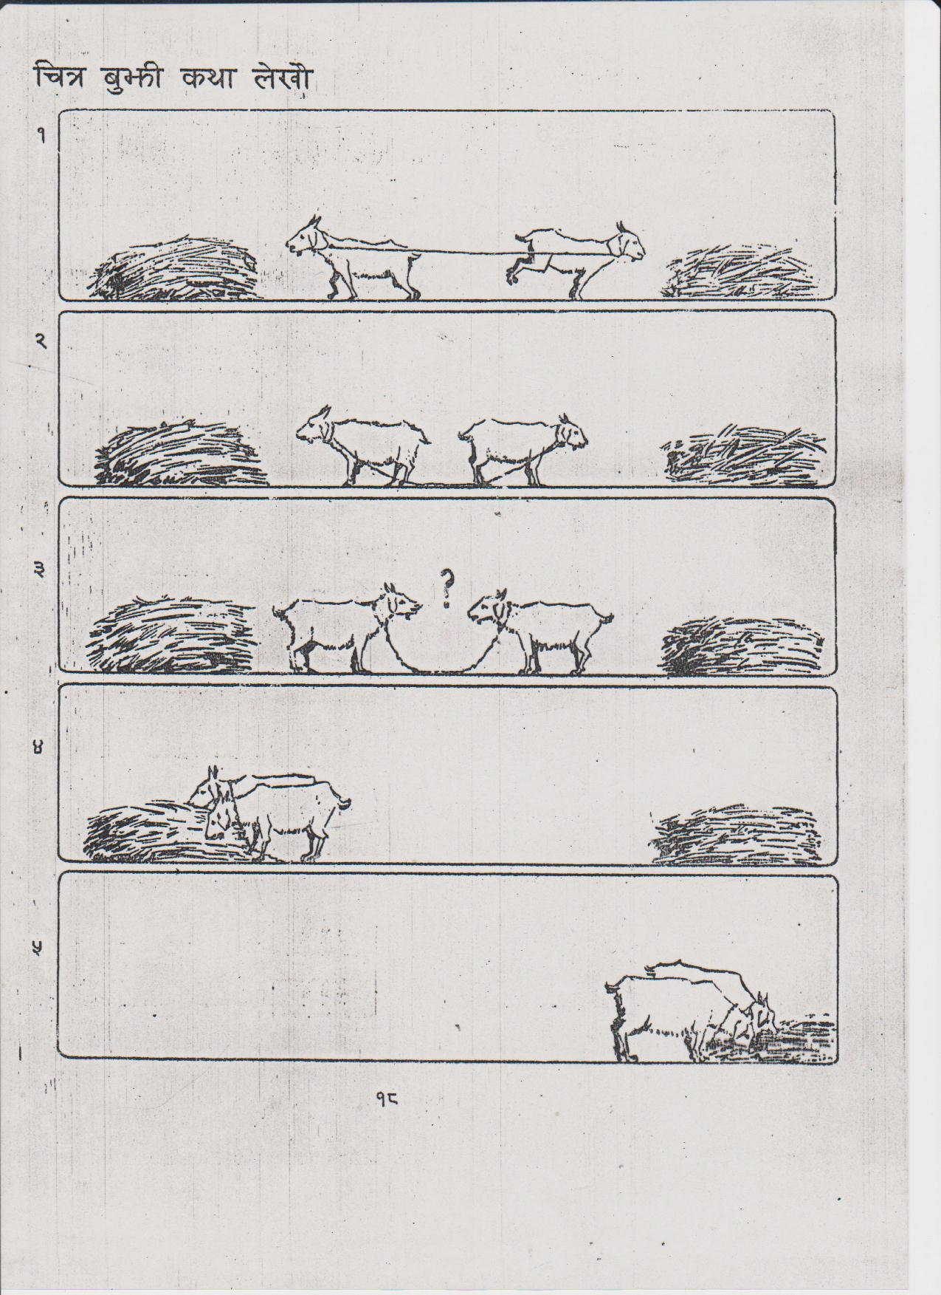

Slide 110
s[kof, sd af]Ng] sL <
ltd|f b'O{ cfFvf 5g\ , b'O{k6s x]/ . b'Oj6f sfg 5g\, b'O{k6s ;'g . Pp6f d'v 5, Psk6s af]n .
sf/0f, df}g /xg' Pp6f 7"nf] xltof/ k|of]u ug{' xf] .
of] s'/f a'em, af]Ng a'l4 eP k'U5, df}g /xg a'l4 / ljj]s rflxG5 .

Slide 111
:jy{ g/fvf}+ .
d vfpF d} nfpF ;'v;on jf df]h d u?F,
d gfr'F d afr'F c? ;a d?g b'a{nx? .
egL bfx|f 3:g] ca'em ;7b]lv 5Ss k/L,
lvTsf 5f]8L ceol;t xfF:of] sfn dl/d/L ..
– slj lz/f]d0fL n]vgfy kf}8\ofn

Slide 112
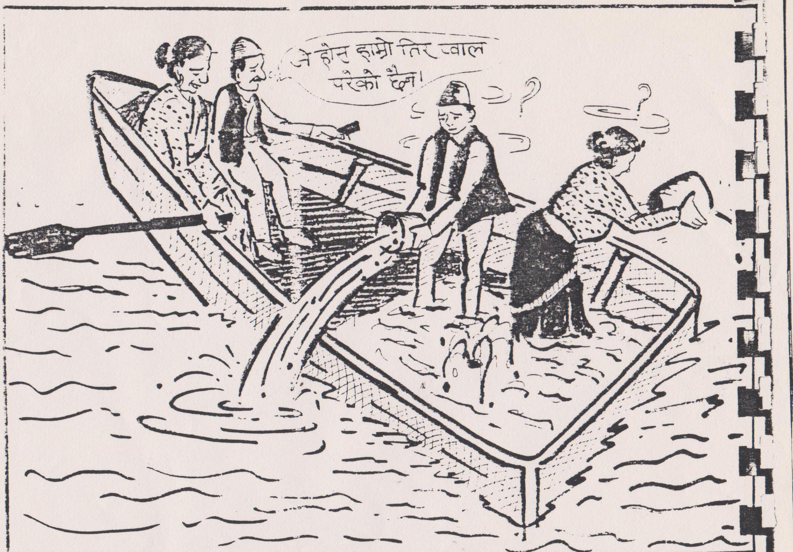
lrqn] s] b]vfFp5 <

Slide 113
bft / lha|f]sf] s'/f .
rLgsf bfz{lgs sGk\mo"l;o; hLjgsf] clGtd If0fdf cf]R5\ofg k/]sf lyP .
1fgsf] nf]eL Ps lzion] clGtd lzIff lbP/ :ju{ hfg cfu|x ug{ yfNof] .
sGk\mo"l;o;n] d'v afo / 1fg lnp eg] . lzio cafs eof] .
pgn] eg] d]/f] bft 5 < lzion] plxNo} em/]sf] s'/f atfof] .
pgn] km]/L d]/f] lha|f] klg em¥of] < egL lzionfO{ ;f]w] . p:n] lha|f] gem/]sf] s'/f atfof] .
ta, sGk\mo"l;o;n] lha|f]sf] nflnTotfn] Tof] bL3{lhaL ePsf] / bft cfs|fds ePsf]n] l56[} em/]sf] 1fg atfO{ lbP .

Slide 114
/fhf zq'af6 hf]luP
Pp6f ;k{ /fhf;+u zq'tf kfn]/ a;]sf] lyof] .
/fhfsf Hof]ltifn] cfh /ftL ;k{ cfP/ 8:g] elaiojf0fL ul/lbP .
/fhfn] ;k{sf] af;:yfgb]lv b/jf/;Ddsf] ;8sdf k"mn 5g{ nufP . 7fp 7fpdf b"w /fVg nufP .
l;kfO{nfO{ ;k{nfO{ g/f]Sg lgb]{zg lbP .
cfk"m ;'Tg] sf]7fsf] 9f]sf / b/jf/sf] d"n4f/ klg v'Nnf ug{ nufP .
;k{ u'8af6 lgl:sof] / ;a} k|aGw b]v]/ x}/fg eP/ /fhfnfO{ g8;L kmls{of] .

Slide 115
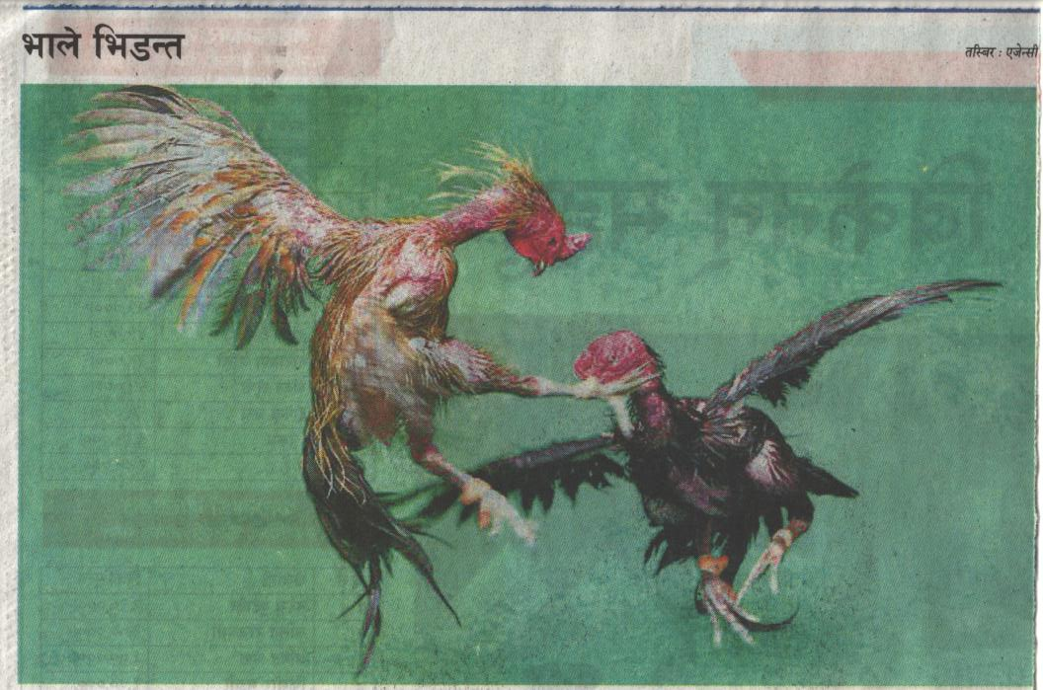
b'vsf] d'xfg M efn] le8Gt .

Slide 116
s|f]wnfO{ xfF;]/ lhTg]
;To o'udf s[i0f, an/fd / ;fTosL jg h+un e|d0fdf lg:s] .
/ftL ;'Tg] avt klxnf] k|x/df ;fTosL kx/f a;] . …s|f]wÚ ?kL lkrf; b]vf k¥of] / 3df;fg n8fO{ eof] .
csf]{ k|x/df an/fd kx/f a;] / o:t} n8fO{ eof] .
t];|f] k|x/df s[i0f kx/f a;] / s|f]w;Fu xfF;]/ s'/f u/] .
s|f]w ;fgf] ls/fdf ?kfGtl/t eof] .

Slide 117
;To tYo
;fFksf bfFtdf laif x'G5 .
lemFufsf] zL/df laif x'G5 .
laR5Lsf] k'R5/df laif x'G5 .
b'i6hgsf] ;a} c+udf laif el/Psf] x'G5 . -rf0fSo_

Slide 118
zq'tf xf]O{g ldqtf a9fpg] ;"q
/x:osf] kbf{kmf; u/f}+ M
zq'n] t s]an z/L/df k|xf/ u5{ .
t/, cfkmGtn] t Åbodf k|xf/ u5{ .
– df;

Slide 119
^= kl/jt{gsf lgodx?
;a}hgf kl/jt{gsf] kIfdf s'/f u5{g,
t/, cfk"m eg] oyf:yltdf /xg rfxG5g\ .

Slide 120
kl/at{g s] xf] / s:n] u5{
;w} ul//xg] lrh ug{ g5f]8];Dd k|ult ;Dea x'b}g .
tkfO{ Tof] sfd ug'{x'G5, hf] ;w} ul//xg'ePsf] 5 eg] tkfO{n] ToxL kfpg'x'g]5, hf] ;w} kfO{/xg'ePsf] 5 .
;+;f/sf ;a}eGbf ;'vL dfG5 tL xf]O{gg\, h:n] w]/} kfPsf 5g\ . tL x'g\, h:n] w]/} lbPsf 5g\ .

Slide 121
hLjg / g]t[Tj
cWof/f]n] cWof/f] wkfpg ;Sb}g, k|sfzn] ;S5 . 3[0fn] 3[0ff wkfpg ;Sb}g, k|]dn] ;S5 .
tkfO{sf sfdn] c?nfO{ clws ;kgf b]Vg, clws l;Sg, clws ug{ / clws aGg k|]l/t u5{ eg] tkfO{ g]tf xf]

Slide 122
;sf/fTds ;f]rn] dfG5]sf sdhf]/L ;lRrG5 .
dfG5]sf af/]df sd / ljrf/sf af/]df al9 lh1f;' ag .
s]xL dflg; slxNo} l;Sb}gg\, lsgeg] pgLx? x/]s s'/f rf+8f] a'e\m5g\ .
g?g] 1fg, gxf:g] bz{g / aRrfsf ;fd' ge\'mSg] dxfgtf Joy{ 5g\ .

Slide 123
dflg;sf] cfbz{
dflg; ;w}e/L ug{ gx'g] sfd ug{af6 8/fcf];\ .
ug'{kg{] sfd gul/PnfsL egL ;fjwfg /xf];\ .
g;f r9\g] lsl;dn] s'g} kbfy{sf] ;]jg gu/f];\ .
ljBf, wg / s'nsf] 3d08 gu/f];\ .

Slide 124
sfFrf] df6f]af6 h] agfof] ToxL aG5 .
Pp6f 7"nf] xfQLnfO{ dfpt]n] n't] 8f]/Ln] v'§fdf afFw]sf] lyof] .
xfQL xnrn gu/L cl8Psf] b]v]/ Pp6f dflg;n] k|Zg u¥of] .
o:tf] ;fgf] 8f]/Lsf] e/df xfQL s;/L sfa"df /Xof] < lsg 8f]/L r'F8fPg <
dfpt]n] hjfkm lbof], of] xfQL aRrf x'Fbf 8f]/Ln] afFw]/ /fv]sf] lyPF . ;f] avt p:n] 8f]/L r'F8fpg vf]Hof], aRrf ePsfn] ;s]g . clxn] o:sf] dgf]lj1fgdf 8f]/L r'F8fpg ;lQmg eGg] k/]sf] 5 . To;}n] n't] 8f]/Lsf] e/d} c8]sf] 5 .
o;y{ dflg;n] gofF lhDd]jf/L kfPkl5 cfkm\gf] ;f]rdf kl/jt{g ug'{k5{ eGg] ;Gb]z o;af6 kfO{G5 .

Slide 125
cfn', c08f / skmLsf] u]8f
tLg cf]6f cnu cnu efF8fdf Ps ;fy cfn', c08f / skmLsf] u]8fnfO{ /fv]/ pdflnof] .
s]xL If0f kl5 x]bf{ ;f/f] cfn' k"0f{tM ulnt eP5 .
leq t/n kbfy{ ePsf] c08f k'gM t/n x'g g;Sg] u/L ;fx|f] eP5 .
skmLsf] u]8f km'6]/ k'/} kfgLnfO{ ;'ulGwt agfO{ lbP5 . klxn]sf] kfgL xfn skmL eP5 .
o;y{ xfdL cfn', c08f jf skmL s] aGg] xfd|} xftdf 5 .

Slide 126
vf]O{ kl/jt{g ePsf] < vf]O{ l;s]sf] <
Pp6f ;]7n] ;'uf kfn]sf] lyof] . ;'uf lkFh8fdf s}b lyof] .
lbgx'F ;]7 wd{kTgL ;lxt hf]uLsf] s'6Ldf ;T;+udf ;fd]n x'g hfGYof] .
Ps lbg ;'ufn] ;]7nfO{ d slxn] lkFh8faf6 d'Qm x'G5' egL hf]uLnfO{ ;f]wL lbg cfu|x u/] .
;]7n] klg hf]uLsf] k|jrg ;lsPkl5 cfkm\gf ;'ufsf] k|Zg ;f]wL lbP . k|Zg ;'Gg] lalQs} hf]uL a]xf];\ eP . pgsf lziox?n] pgsf] pkrf/ cf/De u/] . ;]7 3/ kmls{P .
;'ufn] cfkm\gf] k|Zgsf] s] pQ/ cfof] egL ;f]4f ;]7n] t]/f] efUo g} vf]6f] /x]5, k|Zg ;f]Wg] lalQs} hf]uL a]xf]; ePsf] s'/f atfP . ;'ufn] P a'em]F, wGojfb eg] .

Slide 127
vf]O{ kl/jt{g ePsf] < vf]O{ l;s]sf] <
csf]{ lbg laxfg ;]7 wd{kTgL ;lxt hf]uLsf] s'6L hfg vf]Hbf ;'uf a]xf]; ePsf] b]v]/ xQgkQ lkFh8f vf]n] . df}sf kfpgf;fy ;'uf pF8]/ jgtkm{ k|:yfg u¥of] .
;]7 lvGg x'Fb} hf]uLsf] s'6L k'u] . hf]uLn] lxhf]sf] ;'ufsf] k|Zgsf] k|;+u p7fP . ;]7n] ;'uf a]xf]; ePsf] axfgf agfP/ lkFh8faf6 plDsPsf] s'/f atfP .
hf]uLn] eg] ltdL s}of}F lbgb]lv d]/f] k|jrg ;'gL /x]sf 5f} . d]/f] xfpefp, ;Gb]z ;'lg/x]sf 5f} . t/ s]xL s'/f l;s]sf, u|x0f u/]sf, hLjgdf nfu" u/]sf 5}gf} .
Tof] ;'uf, d]/f] s'6Ldf cfPs} 5}g, d]/f] k|jrg ;'g]s} 5}g . d}n] k7fPsf] Ps ;f+s]lts ;Gb]zaf6} 1fg, h'lQm xfl;n u/L cfkm\gf] nIodf k'Uof] . s;f] <

Slide 128
dfG5]sf] klxrfg
;a}hgf ljZjnfO{ abNg]af/] ;f]R5g\, t/ cfkm}nfO{ abNg]af/] eg] s;}n]klg ;f]Rb}gg\ .
d"v{n] cfk"mnfO{ a'lWbdfg 7fG5 . t/, a'lWbdfgnfO{ cfk"m slt d"v{ 5' eGg] yfxf x'G5 .
dflg;x? tLg y/L x'G5g\, 1fgk|]dL, k|lti7k|]dL / pGgltk|]dL .
dfG5] cfk\mgf b'Mv uGg ?rfp5 t/ ;'v uGg la;{G5 .
dxTjfsf+5f gePsf] a'lWbdfg dfG5] kv]6fljgfsf] r/fh:t} x'G5 .

Slide 129
3tkbf]{
tn v;]sf]nfO{ p7fpg sf]xL cfpb}g .
p7]sfnfO{ tn v;fpg eg] ;a} cfp5g\ .
hxf+ a'l4dfg x'G5g\, Toxf+ ;+jfb x'G5 .
hxf+ d'v{ x'G5g, Toxf+ laafb x'G5 .
lha|f] ;'lw|of] eg],
hLjg ;'lw|g a]/ nfUb}g .

Slide 130
&= gd|tf / ;fbuLkgf
gd|tf s;/L < ;fbf hLhg pRr ljrf/ s] <

Slide 131
c;n dflg;sf u'0fx?
c;n dflg;sf] u'0f M lagd|tf
pksf/L u'0fL JolQm lgx'l/G5 lg/Gt/
kmnn] el/Psf] xfuf]+ ge'ms]sf] sxf+ 5 / <
c;n dflg;sf] u'0f M 3d08 gu/
nf]sdf x'b}g s;}sf] Ps}gfz ;d'Gglt,
c?sf] s] s'/f x]/ ;FWofdf ;"o{sf] ult .
c;n dflg;sf] u'0f M zfGt /xg] M
vx/] u8u6fx6 ;lxt aU5,
gbL ;';fpb} aU5,
;d'Gb| zfGt x'G5 .

Slide 132
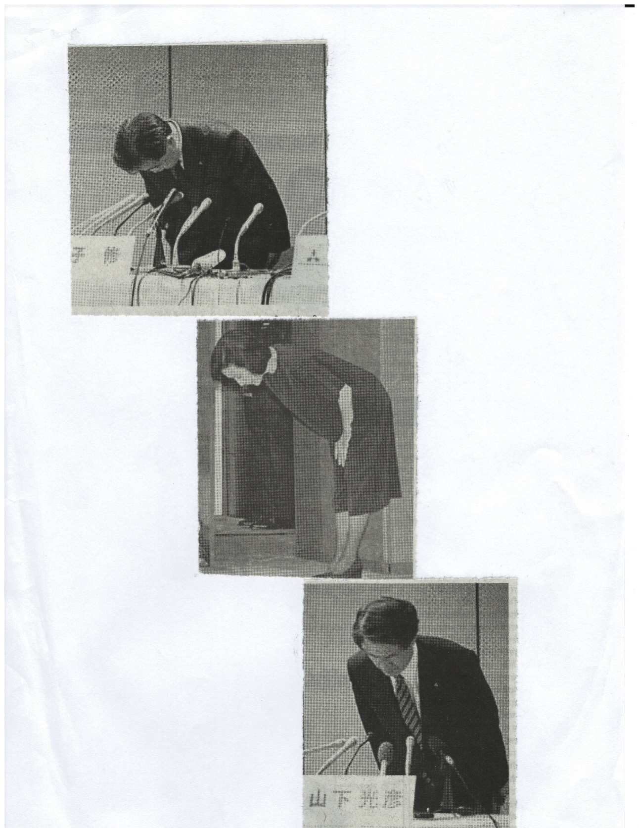
kmnn] el/Psf] xfuf]+ ge'ms]sf] sxf+ 5 / <

Slide 133
;fdfGo dflg; c;fdfGo JolQmTj
8f= dx]Gb|gfy ;/sf/ gfd"b lrlsT;s lyP . pgL :jfdL /fds[i0f k/dx+;sf] k|arg ;'Gg pgsf] cf>d uP . cf>ddf Pshgf k"mnsf] uf]8d]n ul//x]sf lyP . 8fS6/ ;/sf/n] pgL;+u dfnLbfO k/dx+;nfO{ r9fpg] s]xL k"mn lbg';\ g egL df+u] / k"mn kfP . kl5 k|rrg lbg] t pg} dfnL b]lvPsf k/dx+; g} kf] /x]5g\ .
rf0fSon] ul/anfO{ af9\g gof+ l;/s NofP/ lgaf;df /fv]sf lyP . of] rfn kfP/ /ftL rf]/ lgaf;df k:of] . t/ :jo+ rf0fSo yf]qf] l;/sdf sfDb} ;'t]sf] b]v]/ rf]/n] l;/s n}hfg] cf+6 u/]g .

Slide 134
;fdfGo dflg; c;fdfGo JolQmTj
la|6]gsf ljVoft ;flxTosf/ Pr= hL= a]N; cfk"m ;fgf] sf]7fdf a:y] / 7"nf] sf]7fdf ;xofuL] -gf]sgL{_ nfO{ /fVy] .
dxfg a}1flgs dfO{sn km/]h /f]on ;f];fO{6Ldf sfd uy]{ . Pslbg pgnfO{ e]6g pRr clwsf/L e]6g cfpbf Nofjdf ef8f dfemL/x]sf] ca:yfdf e]l6P .

Slide 135
cAb'n snfdsf] ;fbuLkgf
ef/tsf /fi6«klt Plkh] cAb'n snfd j}1flgs x'g\ .
pgL ld;fO{nDofgsf pkgfdn] klg lrlgG5g\ .
pgL ef/tsf] /fi6«klt eP .
pgL /fi6«klt x'Fbf klg cToGt ;fbuL ckgfpy] .
Pp6f sfo{s|ddf pgL k|d'v cltly lyP .
d+rdf Pp6f eJo d]r /flvPsf] lyof] .
;f] eJo d]r cfkm\gf] nflu tof/ u/]sf] a'em] kl5 snfdn] 5]paf6 ;fdfGo d]r tfg]/ To;}df a;] .
;df/f]xdf pkl:yt ;a}n] pgsf] ;fbuLkgf b]v]/ nfdf] ;do;Dd yk8L ahfO{ /x] .

Slide 136
Go"gtd Vofn u/f}+ .
s;}af6 ;xof]usf] ck]Iff ug'{k"a{ p;nfO{ ;xof]u k'/\ofcf}+ .
csf{af6 cfk\mgf] O{R5f k"/f u/fpg klxnf p;s} O{R5f a'em]/ ;f] O{R5f k"/f ul/lbcf}+ .
lbg lxrlsrfpg' / lng O{R5's x'g' /fd|f] xf]O{g .
cfb/ rfxg]n] ;a{k|yd csf{nfO{ cfb/ ug'{k5{ .

Slide 137
;sf/fTds ;f]r s] xf] <
km'nsf] cfFvfdf km'ns} ;+;f/, sf8fFsf] cfFvfdf sf8} ;+;f/ .
d}n] s] kfP xf]Og, d}n] s] lbg ;s] <
of] u/]/ dnfO{ s] kmfObf ls < of] u/]/ dnfO{ s] a]kmfObf <
clxn] gu/] slxn] ug{] < d}n] gu/] s;n] ug{] < eGg] ;f]r xf] .

Slide 138
csf{sf] dg lhTg] ;"q
9f]sfsf] tfNrf vf]n]em} csf{sf] dg vf]Ng' k5{ .
csf{sf] 7f+pdf a;]/ ;f]Rg' k5{ .
;a} gf] sf] JofVof ul/lbg' k5{ .
;b}a lro/k""mn km]; x'g'k5{
;w} csf{sf] s'/fsf] ;+af]wgsf nflu cft'/ x'g'k5{ .

Slide 139
dfG5]sf ;Rrf s'/f .
:jf:Yo ;af]{Qd pkxf/ xf],
;Gt'li6 ;a}eGbf d"Nojfg ;DklQ xf], /
ljZj;gLotf ;af]{Qd ;DaGw xf] .

Slide 140
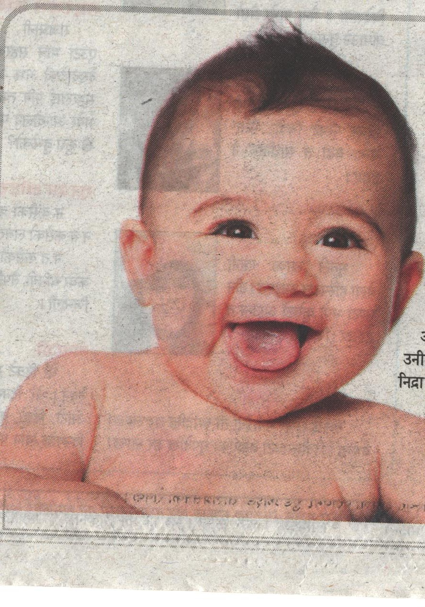
slt nf]enfUbf] / v';Lsf] xf;f] . hLjgdf o:t} xf;f] leq\ofcf}+ .

Slide 141
dflg;sf] d"n ;q'
dflg;sf] d'Vo ;q' l/;, /fu, qmf]w / jf;gf xf] .
o;n] xfd|f] hLjg g} gs{do agfOlbG5 .
qmf]wn] e|d k}bf x'G5 .
e|dn] a'l4 Jou| x'G5 .
ha a'l4 Jou| x'G5, ta ts{ gi6 x'G5 .
ha ts{ gi6 x'G5, ta JolQmsf] ktg x'g yfN5 .
h;n] cfˆgf] dgnfO{ lgoGq0f ug{ ;Sb}g, Tof] dg ;q' a/fa/ xf] .

Slide 142
b'vsf] ;|f]t / o;af6 aflxl/g] h'lQm tyf ;kmn hLjg
hf] JolQm ;w} u'gf;f] u5{, p;nfO{ slxn] klg ;'v ldNb}g .
hf] ;w} z+sf pkz+sf ul//xG5, p;nfO{ klg nf]sdf ;'v ldNb}g .
sltko sfd hLjgdf gug{' g} pQd x'G5 . s}of}+ sfd u/]kl5 hLjgdf bM'v cf/De x'G5 .
csf{nfO{ xf]Rofpg s6' arg af]n]sf] s]xL;do kl5 ;'Gg]nfO{ eGbf af]Ng]nfO{ al9 kL8f x'G5 .
o; hLjgdf u/]sf] s'g}klg sfo{ Joy{ x'b}g . o;y{ ;b}a sd{df h'6g' k5{ .
dg Psbd} rGrn x'G5 . To;}n] o;nfO{ lgoGq0f ug{ s7Lg x'G5 . oBkL cEof;n] o;nfO{ j;df /fVg ;lsG5 .

Slide 143
b'vsf] ;|f]t / o;af6 aflxl/g] h'lQm tyf ;kmn hLjg
JolQmn] h] aGg rfxG5, Tof] aGg ;S5 . oBkL o:sf nflu cfk\mgf] O{R5fnfO{ k"0f{ ljZj;sf ;fy :d/0f ug'{k5{ .
hf] af:tljs 5}g, To;af6 slxn] klg 8/ dfGg' x'b}g .
x/]s JolQmsf] ljZjf; p:sf] :jefj cg';f/ x'G5 .
h'g sd{ k|fs[lts x'b}g, To:n] hlxn] klg tgfa lbG5 .
ha JolQmn] cfˆgf] sfddf cfgGb lng yfN5, ta p+ k"0f{ / of]Uo 7xl/G5 .

Slide 144
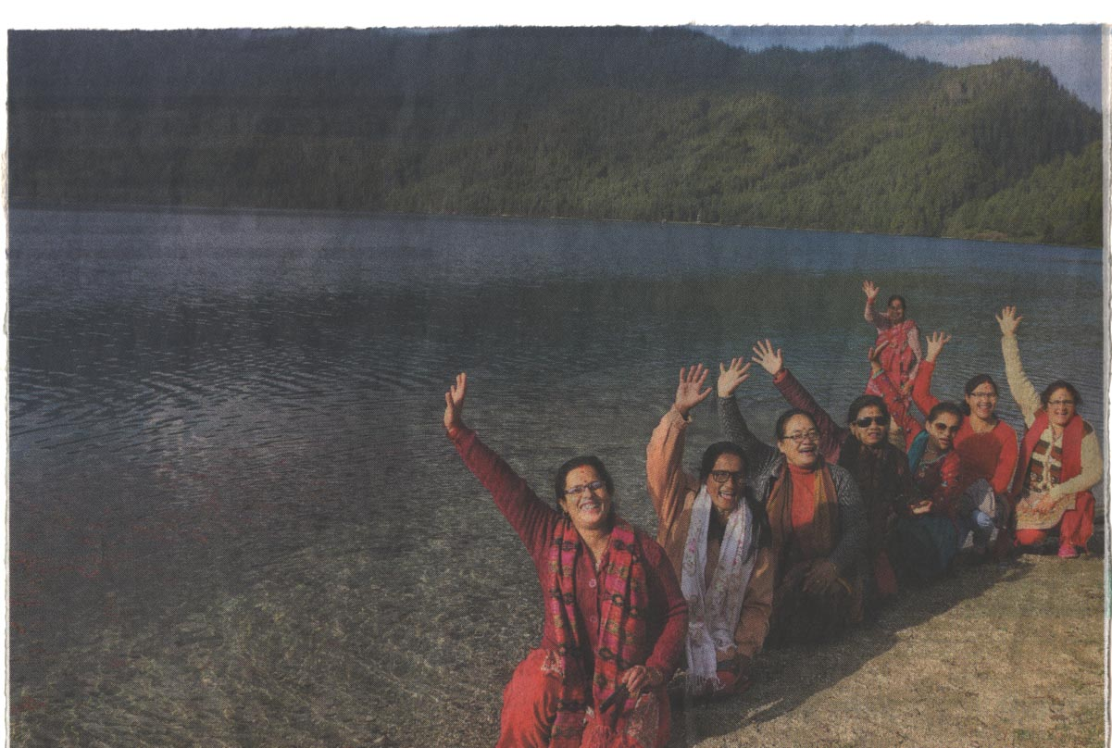
km]/L e]6f}+nf , afO{ , gd:sf/ . s[i0fxl/ af:sf]6f, (*$!#%)@*),khbaskota1@gmail.com

